Slide 1
Placement
Module 4

Slide 2
Agenda
Unit 4.1: Placement
Unit 4.2: Working with Foster Parents to Manage Children’s Behavior and Meet their Needs
Licensing 4.0.2

Slide 3
Unit 4.1
Placement
Licensing 4.1.1

Slide 4
Learning Objectives
Explain the importance of matching a specific foster home to a child’s needs and strengths, whenever possible.
Identify the types of transitions a child in the foster care system may experience on his/her person journey towards permanency.
Identify strategies for maintaining foster homes.
Identify continuing supports for foster parents.
Identify common disruptions and supports to prevent these from occurring.
Licensing 4.1.2

Slide 5

The Last Resort - Most Intrusive
Licensing 4.1.3

Slide 6

Least Intrusive
Why follow a least to most intrusive process?
Licensing 4.1.4

Slide 7
Placement Matching
Analyze the child’s age, gender, sibling status, special physical, educational, emotional and developmental needs, alleged type of abuse, neglect or abandonment, community ties and school placement, and potential responsible caregivers that can meet the child’s needs.
Relatives first, then persons with an established relationship with the child
Adoptive parents of siblings
Utilize the Multiethnic Placement Act of 1994, 42 U.S.C.A. §671(a)(18), and the Interethnic Adoption Provisions.
Comply with the provisions of the Federal Indian Child Welfare Act.
Use the Unified Home Study to determine if a relative or non-relative is responsible and capable of meeting the child’s needs.
When goal is reunification, place in as close proximity as possible to the caregiver.
Licensing 4.1.5

Slide 8
Activity A: Meeting Foster Care Providers
Using the worksheet in the Participant Guide, answer the questions based on the guest speakers’ presentations.
Licensing 4.1.6

Slide 9
Stage III: Placement
Recruitment and Inquiry
Initial Licensing
Placement
Licensing 4.1.7

Slide 10
Partnership Commitments Regarding Placement
Children will be placed only with caregivers who have the ability and are willing to accept responsibility for the care of a child.
DCF, CBC, and agency staff provide caregivers with all available information to assist in determining if they are able to appropriately care for a child.
Responsible Placement
Licensing 4.1.8

Slide 11
Placement Considerations
Matching
Collaboration
Foster parent’s strengths and needs
Attachment considerations
Licensing 4.1.9

Slide 12

Types of Placements
Relative
Non-relative
Child specific
Licensing 4.1.10

Slide 13
Activity B: Bringing Families Together
Review foster care parent profile and child profile.
Answer the questions on the worksheet.
For each child, select the appropriate foster parent match.
Determine the role of the Licensing Specialist in supporting the match.
Licensing 4.1.11

Slide 14

Helping Children Adjust to Placement
Minimize trauma by being aware of and making safe space for child to talk about emotions.
The Licensing Specialist can offer suggestions to the foster parents to make the child feel comfortable on his/her first night of placement.
Licensing 4.1.12

Slide 15
Activity C: First Night
Review the First Night worksheet.
The first column on the table offers suggestions that foster parents can implement to assist with the “first night” of placement.
Develop at least one task the Licensing Specialist can do to assist the foster parent in implementing the suggestions in column A.
Licensing 4.1.13

Slide 16
Funding Sources
Medicaid
Women Infant Children (WIC)
Free/greatly reduced daycare/aftercare/ summer camp
Board rate
Clothing vouchers
Back-to-school supplies
Free breakfast/lunch at school
Tuition waivers for post-secondary education
Licensing 4.1.14

Slide 17
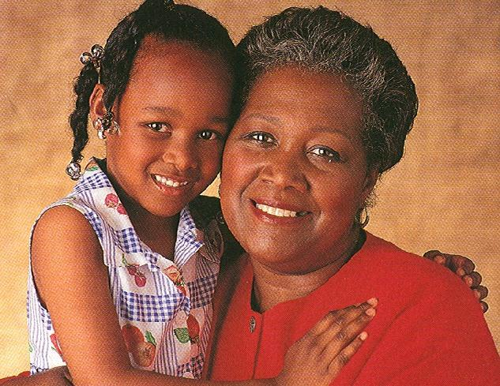
What is Permanency?
Licensing 4.1.15
Notes:
11.4.33

Slide 18
Florida Statute Chapter 39 ~ Permanency
Reunification
Adoption
Permanent guardianship of a dependent child under
Permanent placement with a fit and willing relative under
Placement in another planned permanent living arrangement
Licensing 4.1.16
Notes:
11.4.34

Slide 19

Activity D: Permanency Options
Create a teach-back of the permanency option assigned to your group.
It’s your turn to teach!
Be prepared to discuss.
Licensing 4.1.17

Slide 20
Determining the Best Permanency Goals
Will interventions alleviate the causes of removal.
Current family/other relationships that provide stability.
Ability to provide from the child’s needs on a long-term basis.
Family-like placement options.
Childs preferences.
Licensing 4.1.18

Slide 21

Documentation plays a vital part in achieving permanence for children in a timely manner.
Licensing 4.1.19

Slide 22

Activity E: Which Permanency Options Would You Choose?
Individually read the 4 scenarios and choose which permanency option you think is the best.
Discuss with your table group and see if you agree.
Licensing 4.1.20

Slide 23


Timely Permanency
Make a list of things you can do from the beginning of a case to assure the most appropriate permanency option is chosen.
Licensing 4.1.21

Slide 24

Concurrent Case Planning, s. 39.01(19), F.S.
Establishes case plan permanency goal using reasonable efforts to reunify the child with the parent, while at the same time establishing another goal.
Concurrent efforts to more quickly move children from foster care to a permanent family.
Licensing 4.1.22

Slide 25
Concurrent Case Planning
65C-30.001(30), F.A.C.
“Concurrent Case Planning” means working toward a primary permanency goal while at the same time establishing an alternative permanency goal for the child to be utilized in the event reunification does not occur within a time period that is reasonable with the child’s sense of time.
Licensing 4.1.23
Notes:
11.4.34

Slide 26
Types of Transitions
Transition back to biological parent(s)
Transition to relative placement/ guardianship (this could also be a non-relative)
Transition to independent living
Transition to adoption
Licensing 4.1.24

Slide 27
Transition Back to Biological Parent(s)
Children are excited to return home, but there may also be tension or anxiety:
Children may wonder if it is safe and if the parent has really changed or if change will last.
Children may regress in placement.
Children may want to reject the foster family first to show loyalty to family or to avoid hurt feelings.
Emotions may run high when reunification is planned and is not immediate.
Timing for telling children should be discussed with the team.
Licensing 4.1.25

Slide 28
Transition to Relative Placement/Guardianship
Relatives, non-relatives, and parents who are non-offending may motion for and gain custody even while the previously custodial parent is still working a Case Plan.
This can be stressful for several reasons:
The child may not know the relative very well.
Foster parents must work with a new partner on the team.
Licensing 4.1.26

Slide 29

Transition to Another Foster Home or Group Home
For any number of reasons, children may have to move from one foster home to another foster home or group home.
Some core questions children may have:
Will you respect me?
Will you help me maintain connections?
Will you accept me for who I am?
Licensing 4.1.27

Slide 30
Transition to Independent Living
Many children age out of the system if reunification is not possible and they are not adopted.
A transition plan will be in place to develop self-sufficiency skills.
The Independent Living Program and its benefits are set up to help the youth in this transition.
Licensing 4.1.28

Slide 31
Transition to Independent Living
Benefits of foster parent adoption:
Greater knowledge of a child’s experiences
Knowledge of child’s birth family
Understand their role and relationship with the agency
No need to move to a new family and experience additional loss
Permanency reached more quickly
Allows biological parents know who is permanently caring for their children
Licensing 4.1.29

Slide 32

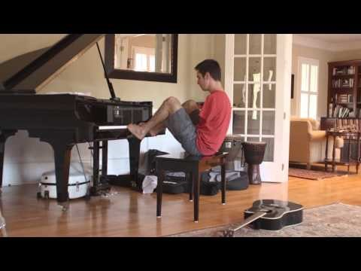
Showtime: Video Review
I Like Adoption
https://www.youtube.com/watch?v=Ggr00IXfZOI
Licensing 4.1.30

Slide 33

Partnership Commitment – Smooth Transitions
Transitions will be accomplished according to a plan involving cooperation and sharing of information.
Licensing 4.1.31

Slide 34
Activity F: Trauma Sensitive Transitions
Read the transition summaries and assign the roles to each participant.
Conduct a staffing where each transition summary is discussed and every member of the team contributes in planning a trauma-informed transition.
Licensing 4.1.32

Slide 35
Foster Parent as Transition-Maker
Provide a loving and safe home
Develop a nurturing relationship with the child
Help the child develop his/her own strategies for resilience as well as build skills
Help the child prepare for the future
Talk with children about the changes that occur with transition
Help children understand their own history and to adjust to losses
Licensing 4.1.33

Slide 36

Partnership Commitment – Avoiding Disruption for Child
Licensing 4.1.34

Slide 37

Disruption in Foster Care
Licensing 4.1.35

Slide 38
Preventing Disruptions
Seek counseling for the child and/or family
Respite care
Request a staffing
Educate oneself on the reasons for and possible strategies for coping
Prevention Strategies
Involve the team
Join a support group
Licensing 4.1.36

Slide 39
When Disruption Does Occur
Change of placement is advisable when:
The safety of the family and other children is in jeopardy.
A reasonable solution cannot be found.
Medical conditions exist that the family is not skilled to handle.
Licensing 4.1.37

Slide 40

Disruption Due to New Placement
Licensing 4.1.38

Slide 41
Disruption Due to Unplanned Runaway
Common reasons for running away:
Missing biological family and the need to maintain connections
Struggling with connections and attachments to foster caregivers
Struggling for autonomy and normalcy
Licensing 4.1.39

Slide 42
Helping Children Understand Their History
Life books
Eco-maps
Life-maps
Life-paths
Information about the child’s birth and family history
Licensing 4.1.40

Slide 43
Activity G: Creating a Life Map
Review sample Life Map.
Create a Life Map using the available materials.
Share your Life Map with others in the class.
Licensing 4.1.41

Slide 44
Unit 4.2
Working with Foster Parents to Manage Children’s Behavior and Meet their Needs
Licensing 4.2.1

Slide 45
Learning Objectives
Explain the role of Licensing Specialists in understanding children’s behaviors and supporting foster parents.
Define secondary trauma and how it impacts Licensing Specialists and foster parents.
Explain how to work with the team to minimize trauma to a child during placement.
Explain the challenges foster parents may experience in working with a child exhibiting evidence of trauma-related behavior and how the Licensing Specialist can assist with facilitating collaboration to manage these challenging behaviors.
Define and explain the policy and practice expectations of normalcy in the life of a child in foster care.
Licensing 4.2.2

Slide 46

Trauma-Sensitive Care
Licensing 4.2.3

Slide 47


Childhood Trauma and Trauma-Sensitive Care
Licensing 4.2.4

Slide 48
Trauma-Sensitive Parenting
Understanding the Impact of Trauma.
Creating a Feeling of Safety and Acceptance
Managing Emotions
Identifying a Child’s Reaction and Response to Trauma
Supporting Connections and Relationships
Helping Child Develop a Strong Sense of Self
Advocating for the Child
Looking at their own Responses
Taking care of Self
Licensing 4.2.5

Slide 49

Helping the Child Heal
Relationships are the most powerful way to heal the brain.
Licensing 4.2.6

Slide 50

Foster Parent Strategies for Responding to a Child’s Trauma
Create Safety
Use Non-verbals
Look at Sensory Triggers
Create the Story
Reintroduce Stimuli
Increase the Child's Comfort
Licensing 4.2.7

Slide 51
Activity H: Partnering to Address Trauma
Using the case scenario assigned, role-play as a Licensing Specialist working with a former parent and child demonstrating the use of one of the strategies presented.
As the Licensing Specialist, demonstrate how you would educate, support, and coach a foster parent who is struggling to respond to a child’s trauma-influenced behaviors.
Repeat the role-play two additional times, using a different scenario so that each person in your group practices the role of the Licensing Specialist.
Licensing 4.2.8

Slide 52

Building Resilience
Resiliency Factors:
Relationship
Connection
Recognized
Control
Invested
Licensing 4.2.9

Slide 53
Activity I: Building Resilience and Healing
In small groups, read the case studies and using the worksheet, respond to the questions.
Licensing 4.2.10

Slide 54

Placement through a Child’s Eyes
Licensing 4.2.11

Slide 55

Transition to Initial Placement
Licensing 4.2.12

Slide 56
Activity J: The Invisible Suitcase
After watching the scene, discuss the following in small groups:
How can you assist foster parents in understanding the feelings and troubling beliefs children may carry about themselves?
What will foster parents need from you when they begin to understand the troubling beliefs and feelings children may have about them?
What can you do as a Licensing Specialist to support foster parents and Case Managers in responding to these beliefs that may only be revealed in challenging behaviors?
How does knowing about the invisible suitcase help you in your work?
Licensing 4.2.13

Slide 57
Activity K: Minimizing Trauma at Initial Placement
In groups, determine how a Licensing Specialist can support foster parents during initial placement key areas.
Put your answers on the flip chart pages on the wall.
Licensing 4.2.14

Slide 58
Foster Parents and Secondary Traumatic Stress
A risk we incur when we engage empathically with an adult or child who has been traumatized.
Foster parents are exposed to all of the trauma that the child carries with them.
In addition, foster parents’ awareness of the trauma the child has experienced creates trauma as they empathize with the child and engage in nurturing behaviors.
The foster parent is also directly exposed to trauma when birth parents are still engaging in destructive behaviors to themselves and others.
Licensing 4.2.15

Slide 59
Activity L: Self-Reflection
Using the worksheet, read the quotation and answer the questions.
Be prepared to discuss with the whole class.
Licensing 4.2.16

Slide 60
Making the Placement Work
Foster Parent/ Child Relationship
Foster Parent/ Team Relationship
Foster Parent Self- Awareness
Licensing 4.2.17

Slide 61
Predictors of Displacement
Child Behavior
Length in Placement
Type of Placement
Availability of Placement
Professional Relationships
Foster Parent Characteristics
Family Relationships
Licensing 4.2.18

Slide 62
Stages of Disruption
Diminishing Pleasure
Child is Problem
Going Public
Turning Point
Deadline
Decision to Disrupt
Licensing 4.2.19

Slide 63

When Disruption Occurs
Safety
No reasonable solution
Medical conditions
Licensing 4.2.20

Slide 64

What Is Normalcy?
Normalcy is the right for ALL YOUTH in licensed out-of-home care to have the opportunity for normal growth and development including age-appropriate activities, responsibilities, and life skills.
Licensing 4.2.21

Slide 65
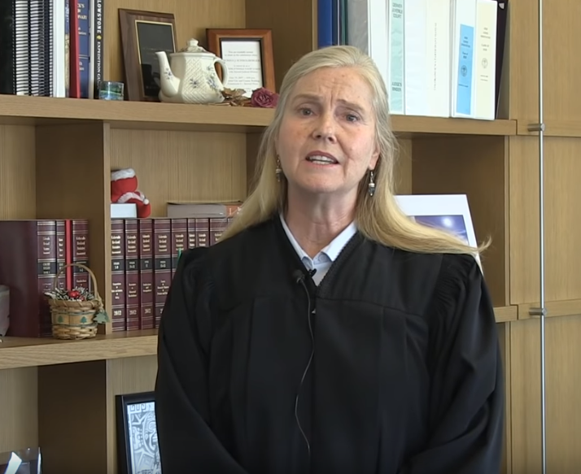
Showtime: Video Review
A Journey to Normalcy
https://www.youtube.com/watch?v=31b71YGXb80
Licensing 4.2.22

Slide 66
Activity M: Normalcy Planning
Review the statute for normalcy and then answer the questions.

