Slide 1
Licensing Level I Foster Homes
Module 3

Slide 2
Agenda
Unit 3.1: Overview of Level I Licensure
Unit 3.2: Level I Licensure
Licensing 3.0.2

Slide 3
Unit 3.1
Overview of Level I Licensure
Licensing 3.1.1

Slide 4
Learning Objectives
Identify the different levels of licensure.
Define the terms: relative, non-relative, and fictive-kin.
Licensing 3.1.2

Slide 5

Foster Home Licensing
  Level I - Child Specific Foster Home
  Level II - Non-Child Specific Foster Home (Currently Traditional Foster Home)
  Level III - Safe Foster Home for Human Trafficking Victims
  Level IV - Therapeutic Foster Home
  Level V - Medical Foster Home
Licensing 3.1.3

Slide 6
Level I Licensure Requirements
Level I-Child Specific Foster Home
    Level I license allows relatives/non-relatives/fictive kin to be paid a foster care board rate.
    Level I licensure is a tailored process for relatives/non-relatives/fictive kin.
      Background Checks
      Waivable Non-safety Items
      Streamlined Educational Resources
At initial placement, the CPI or Case Manager will provide an informational brochure to relatives/non-relatives/fictive kin and notify the designated child welfare professional for licensing.
Licensing 3.1.4

Slide 7


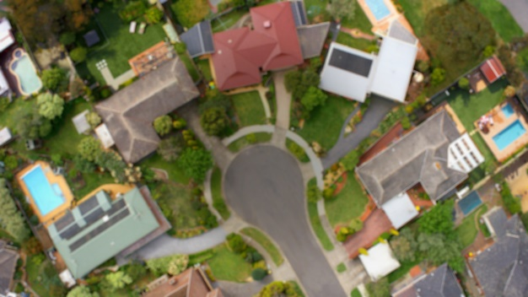
Level I Licensed Individuals
RELATIVES
FICTIVE KIN
NON-RELATIVES
A person who is related by the whole or half-blood, by affinity, or by adoption.
  Grandparent
  Great-grandparent
  Sibling
  First cousin
  Aunt, uncle
  Great-aunt, great-uncle
  Niece or nephew
An individual who is unrelated to the child by either birth or marriage but has such a close emotional relationship with the child that he or she may be considered part of the family.
  Godparents
  Close family friends
An individual who is unrelated to the child either by birth or marriage but has an existing relationship with the child or the family. This may include;
  Teachers
  Neighbors
  Coaches
Licensing 3.1.5

Slide 8

Fictive Kin vs Non-Relative
If the child has an emotionally significant relationship, the caregiver is considered as fictive kin.
If there is not an emotionally significant relationship, the caregiver is considered as non-relative.
Licensing 3.1.6

Slide 9
Unit 3.2
Level I Licensure
Licensing 3.2.1

Slide 10
Learning Objectives
Describe the Unified Home Study process.
Identify the specific requirements for Level I licensure including: Background checks (Ch. 39, F.S. vs Ch. 435, F.S.), Waivable non-safety items, and Streamlined educational resources.
Licensing 3.2.2

Slide 11
Unified Home Study with Emergency Placement
  Child Removed
CPI removes a child and places him/her with a relative/non-relative /fictive kin.
Licensing 3.2.3a

Slide 12
Unified Home Study with Emergency Placement
  Child Removed
CPI removes a child and places him/her with a relative/non-relative /fictive kin.
Background Checks
CPI completes background checks of all household members over the age of 12 and frequent visitors over the age of 18 who provide sight and sound supervision under 65C-28, F.A.C. and 39.0138, F.S.
Licensing 3.2.3b

Slide 13

Unified Home Study with Emergency Placement
  Child Removed
Talk to Caregiver
CPI removes a child and places him/her with a relative/non-relative /fictive kin.
CPI explains the child’s special needs, available support, and danger threats creating the child’s need for out of home placement.
Background Checks
CPI completes background checks of all household members over the age of 12 and frequent visitors over the age of 18 who provide sight and sound supervision under 65C-28, F.A.C. and 39.0138, F.S.
Licensing 3.2.3c

Slide 14

Unified Home Study with Emergency Placement
  Child Removed
Talk to Caregiver
CPI removes a child and places him/her with a relative/non-relative /fictive kin.
CPI explains the child’s special needs, available support, and danger threats creating the child’s need for out of home placement.
Background Checks
Home Evaluation
CPI completes background checks of all household members over the age of 12 and frequent visitors over the age of 18 who provide sight and sound supervision under 65C-28, F.A.C. and 39.0138, F.S.
CPI observes the home for possible dangers and discusses the child’s sleeping arrangements.
Licensing 3.2.3d

Slide 15

Unified Home Study with Emergency Placement
  Child Removed
Talk to Caregiver
Verbal Supervisory Approval
CPI removes a child and places him/her with a relative/non-relative /fictive kin.
CPI explains the child’s special needs, available support, and danger threats creating the child’s need for out of home placement.
CPI obtains supervisor’s verbal approval for the placement before leaving the child in the care of the caregiver.
Background Checks
Home Evaluation
CPI completes background checks of all household members over the age of 12 and frequent visitors over the age of 18 who provide sight and sound supervision under 65C-28, F.A.C. and 39.0138, F.S.
CPI observes the home for possible dangers and discusses the child’s sleeping arrangements.
Licensing 3.2.3e

Slide 16
Unified Home Study with Emergency Placement
  Child Removed
Talk to Caregiver
Verbal Supervisory Approval
CPI removes a child and places him/her with a relative/non-relative /fictive kin.
CPI explains the child’s special needs, available support, and danger threats creating the child’s need for out of home placement.
CPI obtains supervisor’s verbal approval for the placement before leaving the child in the care of the caregiver.
Background Checks
Home Evaluation
Child Placed
CPI completes background checks of all household members over the age of 12 and frequent visitors over the age of 18 who provide sight and sound supervision under 65C-28, F.A.C. and 39.0138, F.S.
CPI observes the home for possible dangers and discusses the child’s sleeping arrangements.
CPI places the child with a relative, non-relative, or fictive kin and finalizes the Unified Home Study.
Licensing 3.2.3f

Slide 17


Unified Home Study with Emergency Placement
  Child Removed
Talk to Caregiver
Verbal Supervisory Approval
CPI removes a child and places him/her with a relative/non-relative /fictive kin.
CPI explains the child’s special needs, available support, and danger threats creating the child’s need for out of home placement.
CPI obtains supervisor’s verbal approval for the placement before leaving the child in the care of the caregiver.
Child Resides with Caregiver
Background Checks
Home Evaluation
Child Placed
CPI completes background checks of all household members over the age of 12 and frequent visitors over the age of 18 who provide sight and sound supervision under 65C-28, F.A.C. and 39.0138, F.S.
CPI observes the home for possible dangers and discusses the child’s sleeping arrangements.
CPI places the child with a relative, non-relative, or fictive kin and finalizes the Unified Home Study.
Licensing 3.2.3g

Slide 18

Available Caregiver Benefits
Child Placed
Child Resides with Caregiver
Cash Only TANF Assistance
Foster Care Board Payment
Relative/Non-relative Caregiver Programs
Licensing 3.2.4

Slide 19
Unified Home Study with Planned Placement
  Caregiver Identified
Talk to Caregiver
Supervisory Approval
Case Manager identifies a relative or non-relative to place the child.
Case Manager explains the child’s special needs, available support, and danger threats creating the child’s need for out of home placement.
Case Manager’s supervisor approves the home study.
Child Resides with Caregiver
Background Checks
Home Evaluation
Child Placed
Case Manager completes background checks of all household members over the age of 12 and frequent visitors over the age of 18 who provide sight and sound supervision.
Case Manager observes the home for possible dangers and discusses the child’s sleeping arrangements.
Case Manager places the child with the relative/non-relative
Licensing 3.2.5

Slide 20




Relative/Non-Relative Caregiver Program vs. Level I Foster Home
Relative/Non-Relative Caregiver Program
Level I Foster Home
Time Frame
60 – 90 days
60 days
Home Study
Payment Rate
$242-$298
$333
Child Support
Educational Support
Additional Resources
Additional Case Mgmt.
Completed Through
ACCESS
Local CBC Licensing
Licensing 3.2.6

Slide 21



Level I Foster Parent Inquiry
  Interested
  Level I Licensing process starts.
  Not Interested
  Child Welfare Professional who made the initial placement introduces the family or individual to the opportunity of becoming a Level I licensed foster home.
  Child Welfare Professional has 2 business days from placement to notify the designated Child Welfare Professional for licensing.
  The designated Child Welfare Professional for licensing contacts the family or individual within 2 business days (even if the caregiver declines initially).
  Relative, non-relative, or fictive kin signs “Notice Of Non-Participation in Licensure” agreement (upload it to the Provider file cabinet in FSFN).
If the caregiver declines to be a Level I foster parent initially,
The designated child welfare professional should contact the caregiver once a month to remind the opportunity.
The caregiver still has the opportunity for licensure at a later date.
Licensing 3.2.7

Slide 22

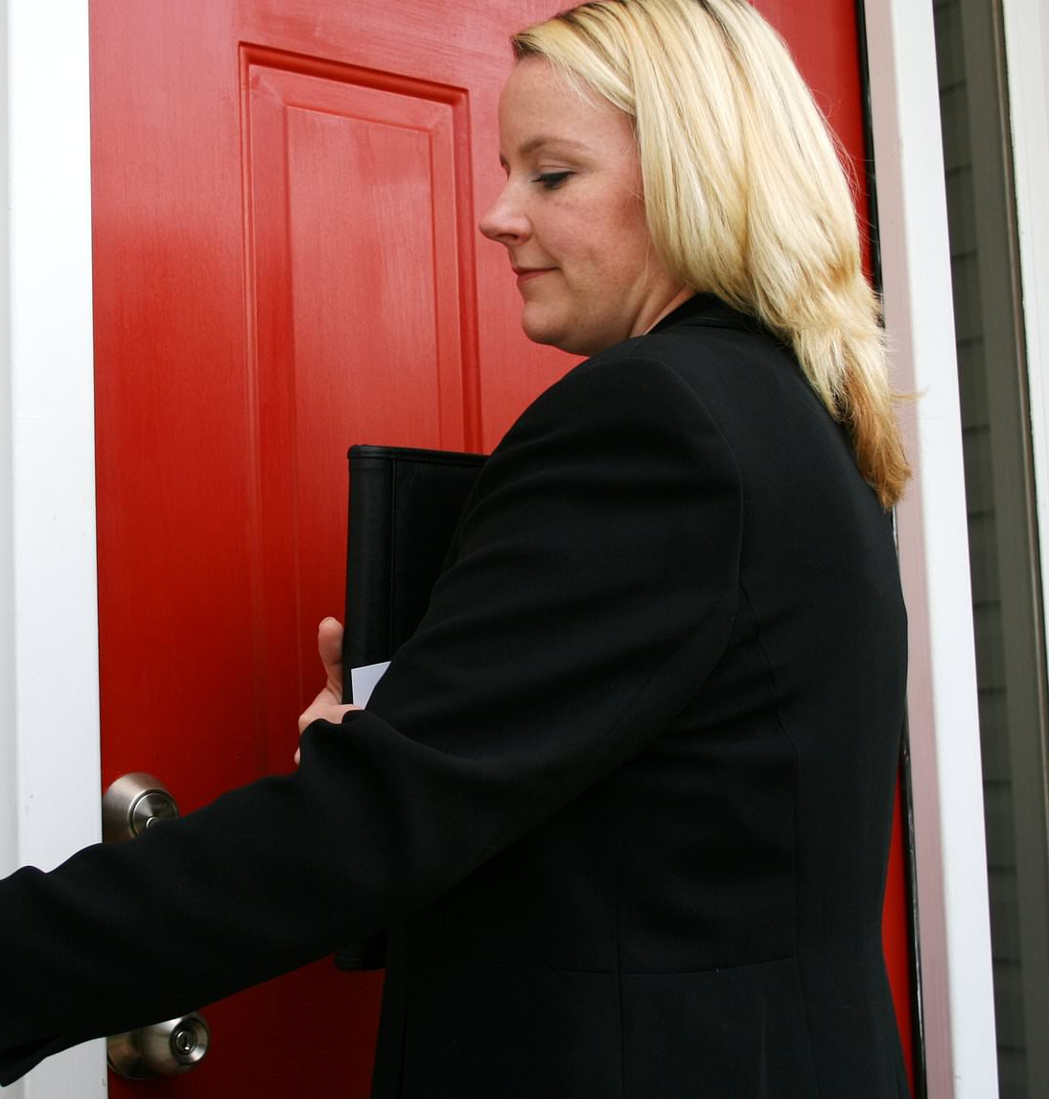
First Child Caregiver Visit
Within two business days of notification of the placement, the Licensing Specialist will need to reach out to the caregiver to explain the benefits of becoming Level I - Child Specific Foster Home.
  Who will contact the caregiver?
  How will the caregiver be contacted?
  Who will conduct the briefing? How will the process be described?
  Where will the briefing take place?
  What is process of contacting the caregiver again if the caregiver initially declines to be licensed?
Licensing 3.2.8

Slide 23

Case Managers Role
Verbal Supervisory Approval
Notification of CBC within 2 business days
Caregiver chooses to be licensed
  Child Removed
Talk to Caregiver
Licensing will complete a Unified Home Study for
Level I Foster Home.
If licensing does not complete the Unified Home Study within 45 days of transferring the case, the Case Manager must complete an updated home study.
Within 45 days of transferring the case to case management
  Case Manager will complete a Unified Home Study for Relative/Non-Relative placement.
Background Checks
Home Evaluation
Child Placed
Caregiver chooses not to be licensed
Licensing 3.2.9

Slide 24





Level I Licensure Process
Step 2
Step 4
The Child Welfare Professional conducts background screenings for all household members over the age of 12.
The Child Welfare Professional determines if there are any non-safety waivable items and provides justifications.
DENIED
If the caregiver is denied for Level I licensure, he or she can still apply for the relative/non-relative caregiver benefits.
  Family/Individual wants to be licensed
  Background Screening
  Educational Resources
  Home
  Evaluation
  Regional Approval
Step 1
Step 3
Step 5
A designated Child Welfare Professional contacts the caregiver seeking licensure within 2 business days.
The caregiver interested in becoming a Level I Foster Parent completes the required review of Educational Resources.
The designated Child Welfare Professional submits all required documents for regional approval.
LICENSED
Make all efforts to complete the Level I process within 60 business days
Licensing 3.2.10

Slide 25

Level I Licensure Requirements
Background Screening
Background screening is REQUIRED for:
      All household members residing in a home seeking licensure
      New household members
  Background sources will also remain the same.
  Federal, statewide, and local criminal record checks (including DJJ record checks for household members between the age of 12-17)
  Florida Sexual Offenders and Predators registry record checks
  Abuse and neglect records checks through FSFN
  Civil court checks for domestic violence
  911 Call-Outs
Out-of-state civil records and orders of protection have been removed for all foster parents.
Licensing 3.2.11

Slide 26
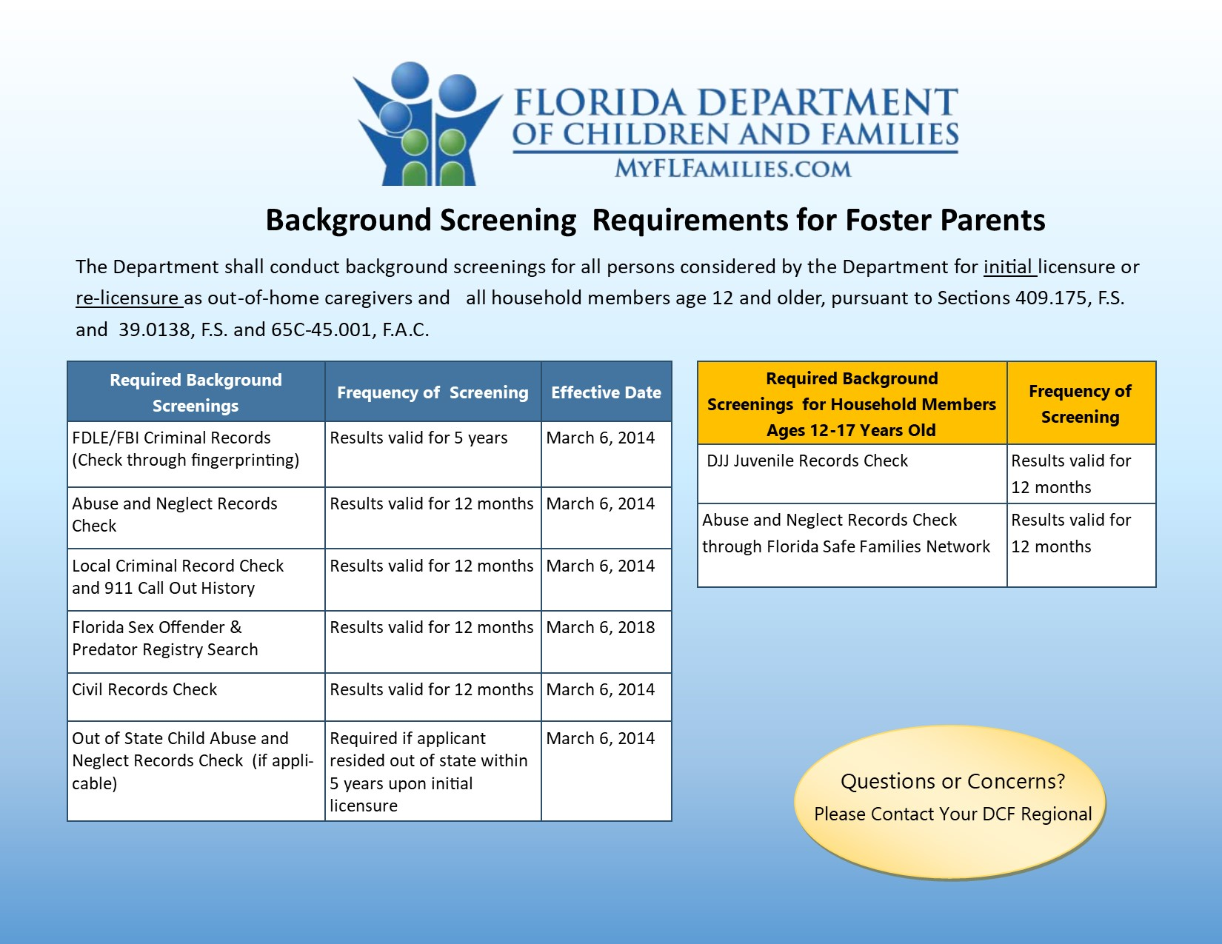
Level I Licensure Requirements
Background Screening Tip Sheet
Licensing 3.2.12

Slide 27


Educational Resources
The required number for educational resource (training) hours for Level I licensure is 2 (two) hours
Licensing 3.2.13

Slide 28

Non-Safety Waivable Items
Non-safety waivable item means a licensing requirement waivable under the Level I-Child Specific Foster Home license.
  Under the LEVEL I-CHILD SPECIFIC FOSTER HOMES, some non-safety items are waivable on a case-by-case basis. Waivable items require alternative accommodations for the child(ren).
When you waive a non-safety item, you must justify the reason(s).
Licensing 3.2.14

Slide 29
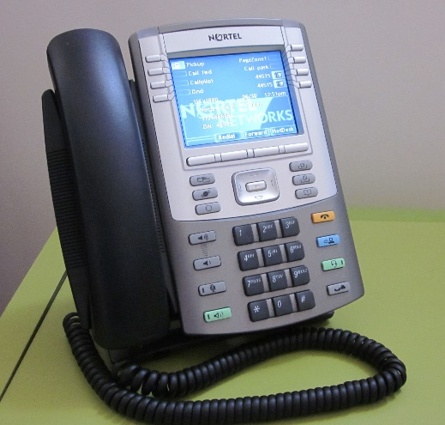
Level I-Child Non-Safety Waivable Items
  Accommodation
  Waivable?
Waivable
  A phone within close proximity to the house for emergency purposes is acceptable.
  Non-Waivable?
  Phone
Licensing 3.2.15
Notes:
Remind participants that some of the policies and forms are still in draft.

Slide 30
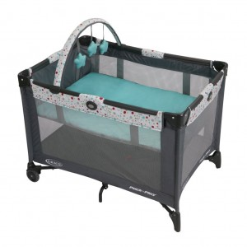

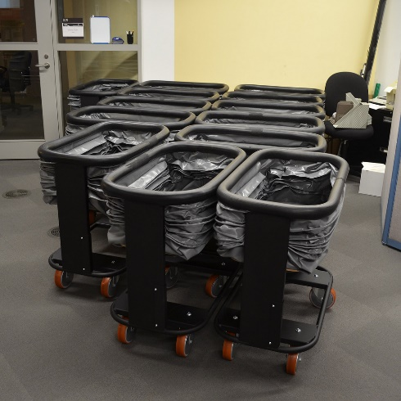
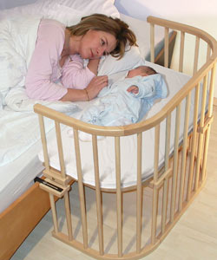
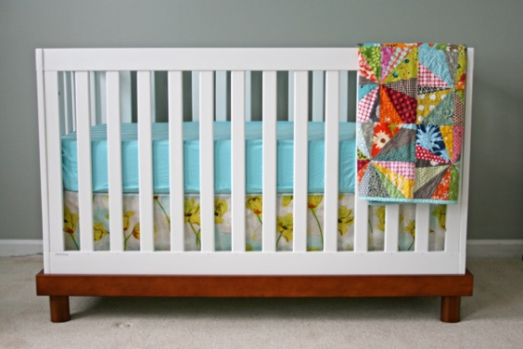
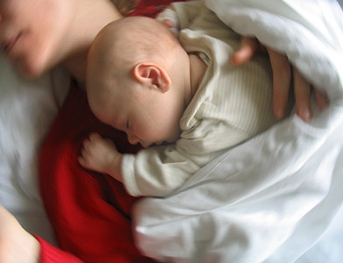
Level I-Child Non-Safety Waivable Items
  Accommodations
  Waivable?
Waivable
  Pack n’ play
  Bassinets
  Non-Waivable?
  Not Acceptable
  Baby Crib
  Co-sleeping with an adult or child
Licensing 3.2.16

Slide 31
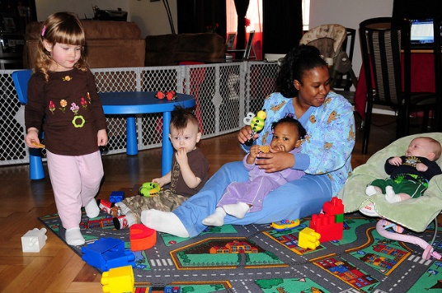
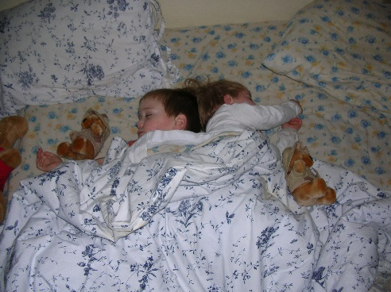
Level I-Child Non-Safety Waivable Items
  Accommodation
  Waivable?
  Child care may be provided on an ongoing basis with an individual chosen by the caregiver that is not a licensed child care provider.
Waivable
  Non-Waivable?
  Licensed Child Care
  Waivable?
  Accommodation
Waivable
  Children older than 18 months may share a bed with a sibling if there is a sleeping space able to accommodate the children.
  Non-Waivable?
  Child Sharing Bed with Another Child
Licensing 3.2.17
Notes:
Remind participants that some of the policies and forms are still in draft.

Slide 32
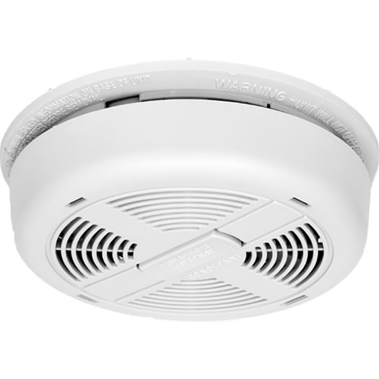

Level I-Child Non-Safety Waivable Items
  Accommodation
  Waivable?
  There is a smoke detector in close proximity to the bedroom, and there must be one in the home that works.
Waivable
  Non-Waivable?
  Smoke Detector
  Accommodation
  Waivable?
  If there is a documented evacuation plan from unified home study, another plan is not required.
Waivable
  Non-Waivable?
  Evacuation Plan
Licensing 3.2.18
Notes:
Remind participants that some of the policies and forms are still in draft.

Slide 33
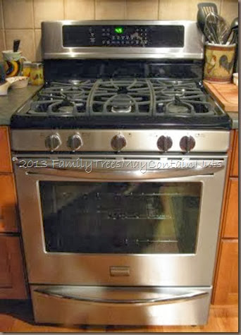

Level I-Child Non-Safety Waivable Items
  Accommodation
  Waivable?
  If gas and oil equipment is used inside the home, the licensing specialist should review carbon monoxide information and document in a provider note.
Waivable
  Non-Waivable?
  Carbon Monoxide
  Accommodation
  Waivable?
Waivable
If a radon test is conducted and results are not favorable, the licensing specialist should provide radon referral information and document the information in a provider note.
  Non-Waivable?
  Radon Test
Licensing 3.2.19

Slide 34


Level I-Child Non-Waivable Items
  Waivable?
Non-Waivable
  Background Checks are not WAIVABLE.
  Non-Waivable?
  Background Checks
  Waivable?
Non-Waivable
  Educational Support is not WAIVABLE.
  Non-Waivable?
  Educational Support
Licensing 3.2.20

Slide 35
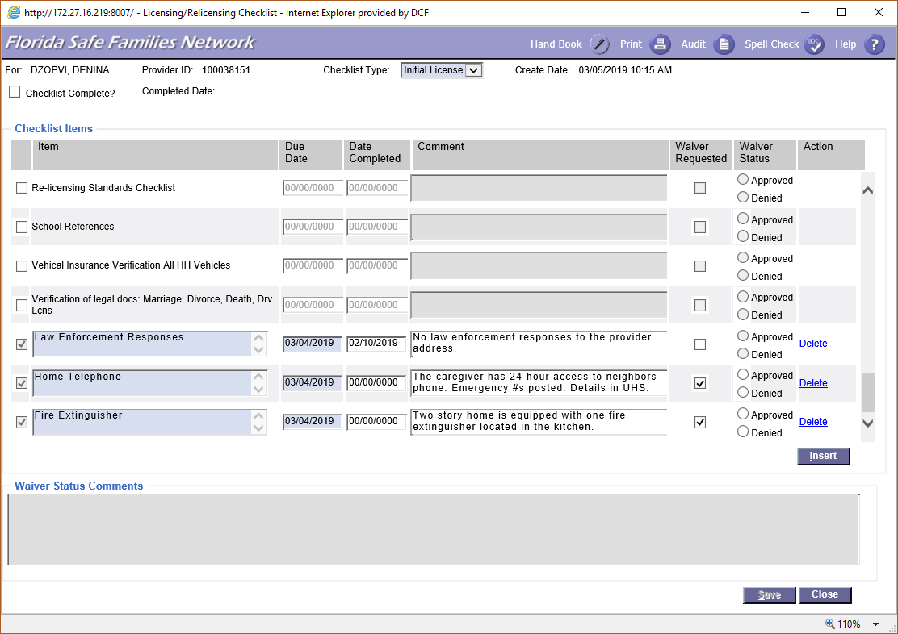
FSFN Waiver Request
Naming conventions for FSFN “item” column are located on the waivable tip sheet.
    Licensing Checklist – Waiver Requested
Licensing 3.2.21

Slide 36
Ongoing Caregiver Support
  Support Groups: Local foster/adoptive parent associations
  Ongoing Licensing Compliance Supports:
    Level I - Quarterly contact (documented in FSFN)
  Supports for Children Placed in Home:
    Child Care Assistance
    Clothing Allowance
    Additional Benefits Identified by CBC
Licensing 3.2.22

Slide 37
Local Referral Process
How much information will the Child Welfare Professional share with caregivers?
How will the Child Welfare Professional who makes the initial placement contact the Child Welfare Professional who is responsible for licensing?
Who will talk to the caregiver?
Which method will be used to contact the caregiver (e.g., home visit, phone call, etc.)?
How will you follow up with the caregiver if the caregiver initially declines to be licensed?
Licensing 3.2.23

