Slide 1

Module 8
Safety and Risk
Notes:
7.1.1

Slide 2

Agenda
Pre-Service Curriculum Module 8.0.2
Notes:
7.0.2

Slide 3
Unit 8.1
Assessing Present Danger
Pre-Service Curriculum Module 8.1.1
Notes:
7.1.1

Slide 4

Learning Objectives
Pre-Service Curriculum Module 8.1.2

Slide 5
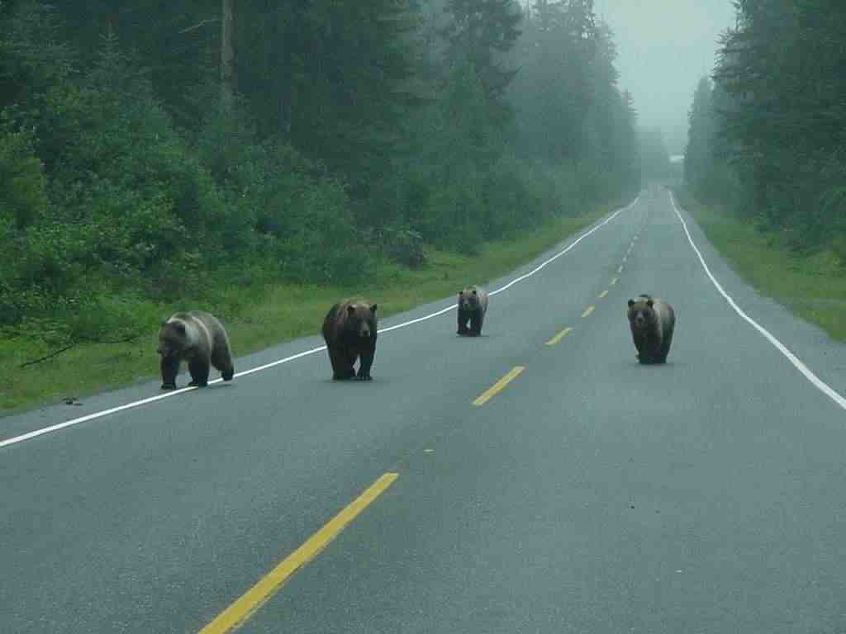
Present Danger?
Pre-Service Curriculum Module 8.1.3
Notes:
7.1.3

Slide 6
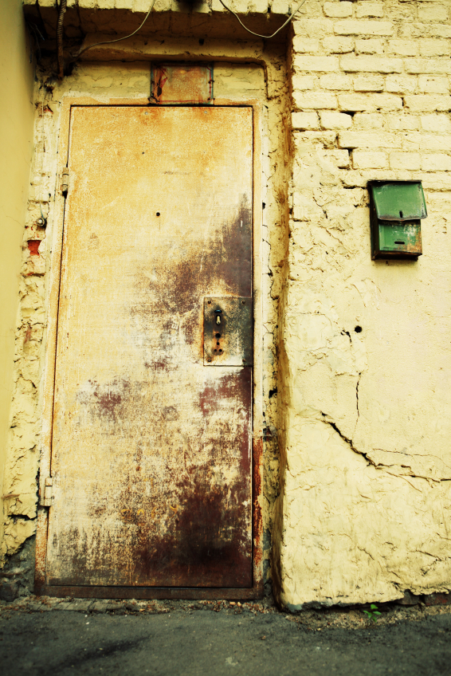
Present Danger
Evaluating child safety at initial contact.
An immediate, significant and clearly observable family condition occurring in the present tense, endangering or threatening to endanger a child and therefore requiring prompt CPS response.
Pre-Service Curriculum Module 8.1.4
Notes:
7.1.4

Slide 7
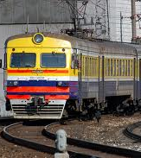
Impending Danger
Child living or being in a position of continual or pervasive danger.
Threats are not immediate, obvious or active at the onset of investigation.
Are identified and understood upon gathering sufficient family functioning information.
Pre-Service Curriculum Module 8.1.5
Notes:
7.1.5

Slide 8
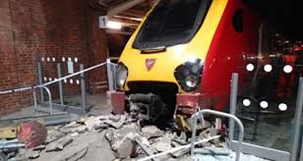
The Train was Coming--
Pre-Service Curriculum Module 8.1.6
Notes:
7.1.6

Slide 9
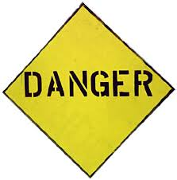
Danger Threats: Qualifying Present Danger
Danger Threats:
11 Danger Threats;
Used to qualify/identify present danger;
Descriptions of family conditions that are immediate, significant, clearly observable.
Pre-Service Curriculum Module 8.1.7

Slide 10

Activity: Identify Present Danger Threats
Pre-Service Curriculum Module 8.1.8

Slide 11
Activity: Present Danger Case Scenario
Pre-Service Curriculum Module 8.1.9

Slide 12
Unit 8.2
Impending Danger, Information Sufficiency and Danger Threats
Pre-Service Curriculum Module 8.2.1
Notes:
7.2.1

Slide 13
Learning Objectives
Pre-Service Curriculum Module 8.2.2

Slide 14
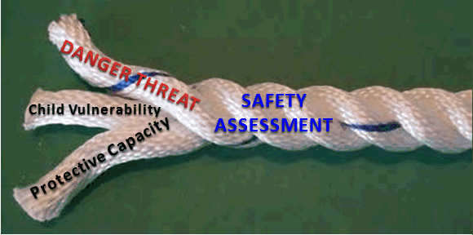
Is a child in impending danger?
Pre-Service Curriculum Module 8.2.3

Slide 15
Family Conditions: Impending Danger?
Safe Child:
Negative family conditions are able to be controlled/
managed by the family
Threshold Criteria:
Observable
Out of Control
Severe
Imminent
Vulnerable Child
Unsafe Child: Negative family conditions have crossed the danger threshold and are no longer able to be managed/controlled by the family
Pre-Service Curriculum Module 8.2.4
Notes:
7.1.7

Slide 16
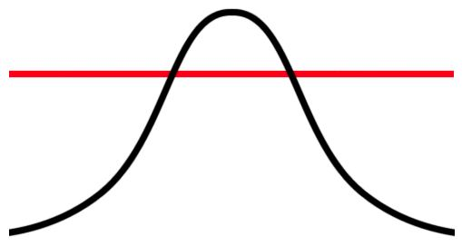
Differentiating Family Conditions: Danger Threshold Criteria
Observable
Out of Control
Severe
Imminent
Vulnerable Child
Pre-Service Curriculum Module 8.2.5

Slide 17
Activity: Negative Family Conditions
Pre-Service Curriculum Module 8.2.6

Slide 18
Danger Threats: Qualifying Impending Danger
Danger Threats:
11 Danger Threats;
Used to qualify/identify impending danger;
Descriptions of family conditions have crossed the safety threshold-from safe to unsafe.
Pre-Service Curriculum Module 8.2.7

Slide 19
Information Collection
KNOW THE FAMILY
Extent of Maltreatment
Surrounding Circumstances
Child Functioning
Adult Functioning
Disciplinary Practices/Behavior Management
General Parenting Practices
Pre-Service Curriculum Module 8.2.8

Slide 20
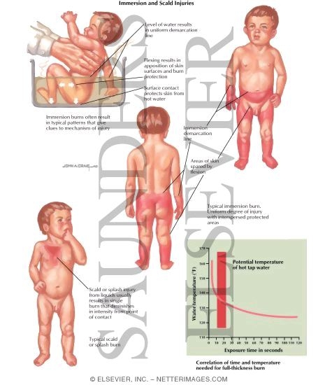
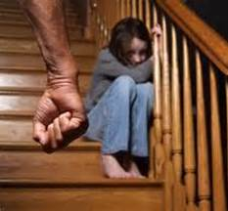
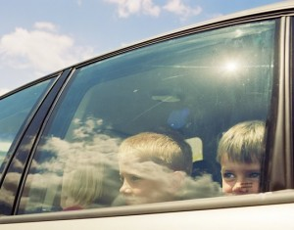
Domain 1: Child Maltreatment
Pre-Service Curriculum Module 8.2.9

Slide 21
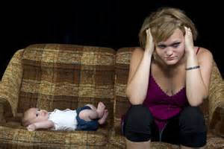
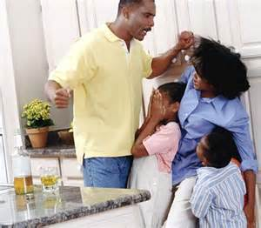
Domain 2: Circumstances Surrounding Maltreatment
Pre-Service Curriculum Module 8.2.10

Slide 22
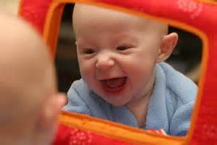
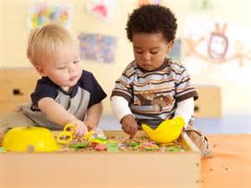
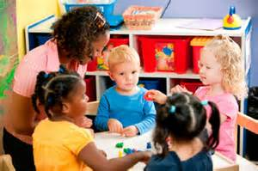
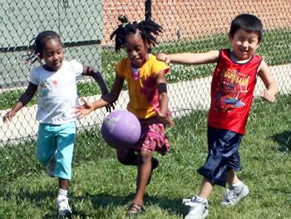
Domain 3: Child Functioning
Pre-Service Curriculum Module 8.2.11

Slide 23
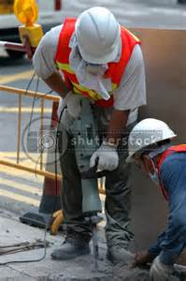
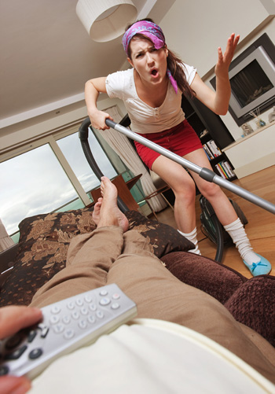

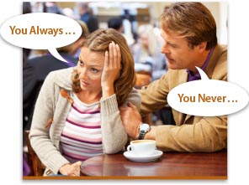
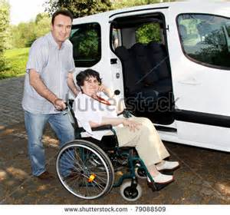
Domain 4: Adult Functioning
Pre-Service Curriculum Module 8.2.12

Slide 24
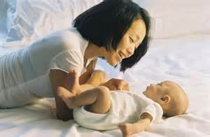
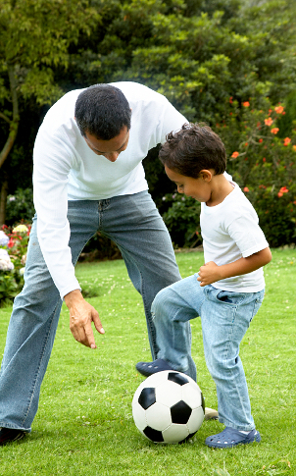
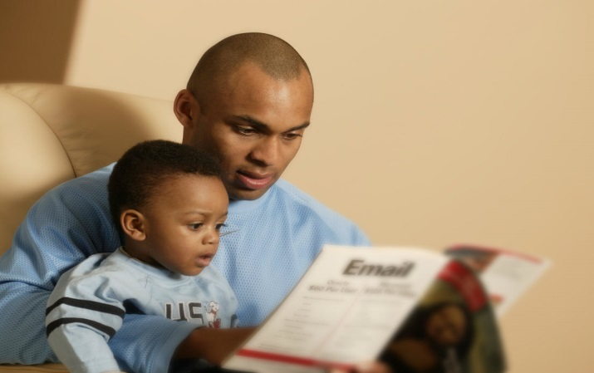
Domain 5: Parenting Practices
Pre-Service Curriculum Module 8.2.13

Slide 25
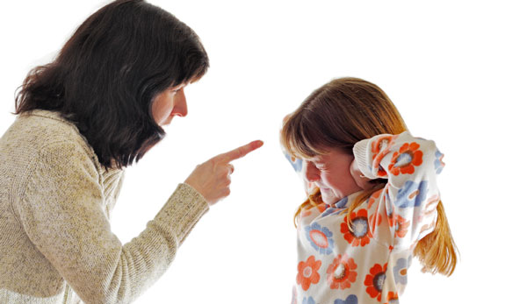
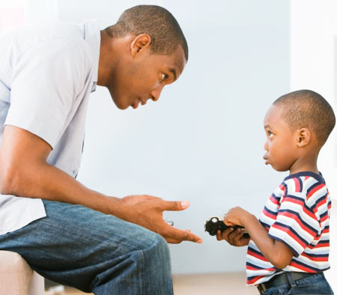
Domain 6: Discipline/Behavior Management
Pre-Service Curriculum Module 8.2.14

Slide 26
Unit 8.3
Impending Danger, Information Sufficiency and Caregiver Protective Capacities
Pre-Service Curriculum Module 8.3.1

Slide 27
Learning Objectives
Pre-Service Curriculum Module 8.3.2

Slide 28
Is a child in impending danger?
Pre-Service Curriculum Module 8.3.3

Slide 29
Differentiating Family Conditions: Danger Threshold Criteria
Observable
Out of Control
Severe
Imminent
Vulnerable Child
Pre-Service Curriculum Module 8.3.4

Slide 30
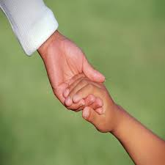
Definition: Caregiver Protective Capacities
Caregiver protective capacities are personal and caregiving behavioral, cognitive and emotional characteristics that can be specifically and directly associated with being protective of one’s young.
Pre-Service Curriculum Module 8.3.5

Slide 31

Behavioral Protective Capacity
Specific action, activity, or performance that is consistent with, and results in, protective parenting and protective vigilance.
Pre-Service Curriculum Module 8.3.6

Slide 32

Cognitive Protective Capacity
Specific intellect, knowledge, understanding and perception that results in protective parenting and protective vigilance.
Pre-Service Curriculum Module 8.3.7

Slide 33
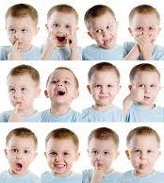
Emotional Protective Capacity
Specific feelings, attitudes, identification with child and motivation that results in protective parenting and protective vigilance.
Pre-Service Curriculum Module 8.3.8

Slide 34
Domain 1: Child Maltreatment
Pre-Service Curriculum Module 8.3.9

Slide 35
Domain 2: Circumstances Surrounding Maltreatment
Pre-Service Curriculum Module 8.3.10

Slide 36
Domain 3: Child Functioning
Pre-Service Curriculum Module 8.3.11

Slide 37
Domain 4: Adult Functioning
Pre-Service Curriculum Module 8.3.12

Slide 38
Domain 5: Parenting Practices
Pre-Service Curriculum Module 8.3.13

Slide 39
Domain 6: Discipline/Behavior Management
Pre-Service Curriculum Module 8.3.14

Slide 40
Unit 8.4
Impending Danger, Information Sufficiency and Child Vulnerability
Pre-Service Curriculum Module 8.4.1

Slide 41
Learning Objectives
Pre-Service Curriculum Module 8.4.2

Slide 42
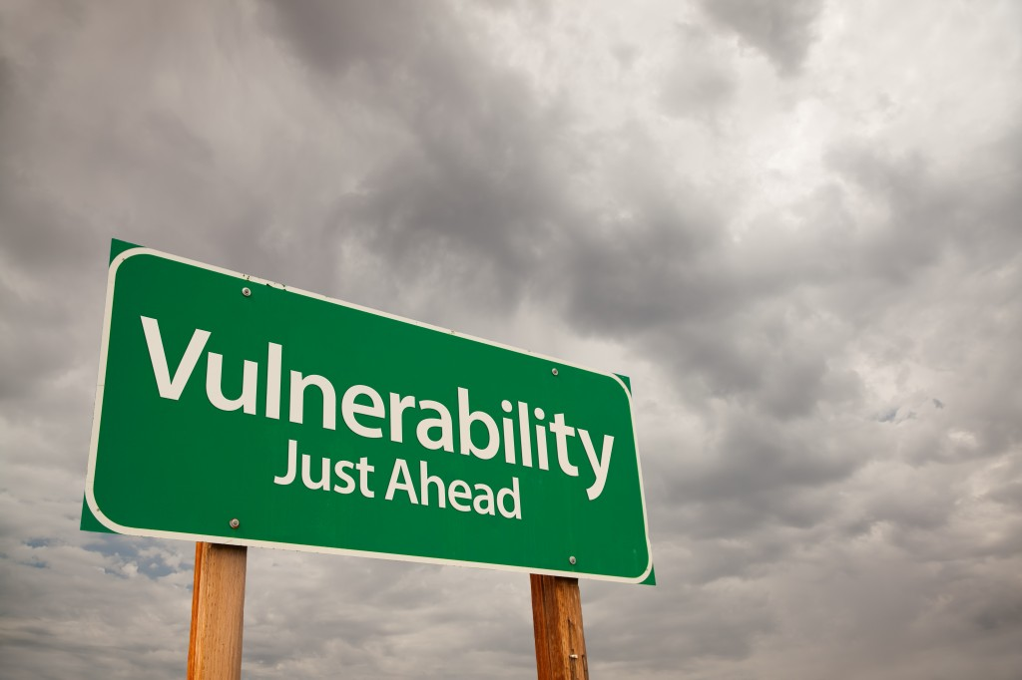
Vulnerable Child
images
Pre-Service Curriculum Module 8.4.3
Notes:
As we think about how to engage the family in order for us to get to know them, let’s look in more depth at each of the domains—and the type of information we want to know in each area.

Slide 43
Vulnerable Child
A vulnerable child refers to a child who is dependent on others for protection and is exposed to circumstances that she or he is powerless to manage. The child is susceptible, accessible and available to a threatening person and/or persons in authority over them. Vulnerability is judged according to age; physical and emotional development; ability to communicate needs; mobility; size and susceptibility.
Pre-Service Curriculum Module 8.4.4

Slide 44
Potential Impacts of Danger Threats on Child Functioning
Physical injury
Emotional trauma
Basic care needs of child
Basic care needs of siblings
Special care needs
Delays in child development
Disruption in housing
Academic performance, including disruption in schools
Social skills
Intellect
Self-control
Behavior patterns
Mood changes
Eating and sleeping habits
Sexual behavior
Pre-Service Curriculum Module 8.4.5
Notes:
When we consider child functioning, we are hoping to understand how the child is from day to day… their general functioning. We must not limit our focus to simply understanding how they were behaving when the maltreatment occurred, or how they acted when we were in the home. Some of the things we want to understand include the child’s level of trust, their sociability, self-awareness, verbal or communication skills and their independence and assertiveness. Some of the other child functioning areas include motor stills, overall intellect and self control. We also want to consider their behavior patterns and mood changes, their eating and sleeping habits, and their sexual behavior.

Slide 45
Safe
Safe: A child can be considered “safe” when there is no threat of danger to a child within the family/home or when the caregiver protective capacities within the home can manage threats of danger
Unsafe: A child is considered “unsafe” when there is a danger threat to a vulnerable child within a family/home and the caregiver protective capacities are insufficient to manage the threat of danger, thus requiring outside intervention
Pre-Service Curriculum Module 8.4.6

Slide 46
Unit 8.5
Risk, Protection and Prevention
Pre-Service Curriculum Module 8.5.1

Slide 47
Learning Objectives
Pre-Service Curriculum Module 8.5.2

Slide 48

Protect the Vulnerable
Pre-Service Curriculum Module 8.5.3

Slide 49

Protecting the Child Through Prevention
Pre-Service Curriculum Module 8.5.4

Slide 50
Financial & Social Costs of Maltreatment
Avg. Lifetime Cost Per Victim (nonfatal): $210,012
Avg. Lifetime Cost Per Victim (fatal): $1,272,900
Social Cost: Abuse and neglect tend to perpetuate throughout generations unless intervention of some kind occurs.
Pre-Service Curriculum Module 8.5.5

Slide 51

What does “at Elevated Risk of Maltreatment” mean?
Pre-Service Curriculum Module 8.5.6
Notes:
Information Drives Decisions About Safety… that’s an important concept going forward…

Slide 52

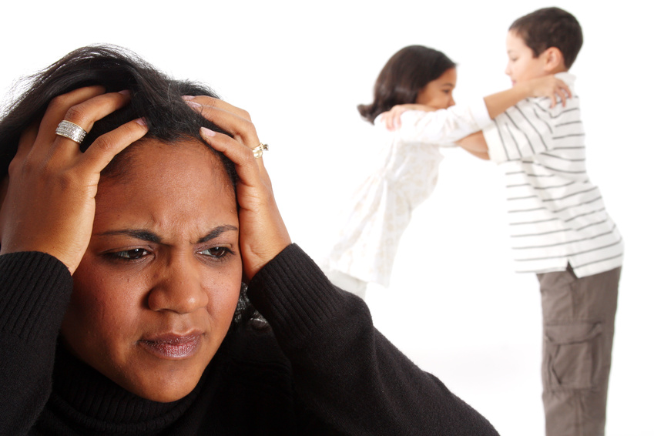
Protection, Risk and Prevention
Pre-Service Curriculum Module 8.5.7

Slide 53
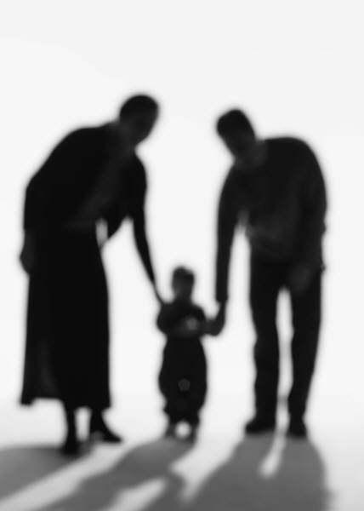
Protection vs. Risk
Pre-Service Curriculum Module 8.5.8

Slide 54
Activity: Child and Adult Functioning, General Parenting, and Family Protective Factors
Pre-Service Curriculum Module 8.5.9

Slide 55
Unit 8.6
How Safety & Risk Work to Address Two Different Aspects of Protecting Vulnerable Children
Pre-Service Curriculum Module 8.6.1

Slide 56
Learning Objectives
Pre-Service Curriculum Module 8.6.2

Slide 57
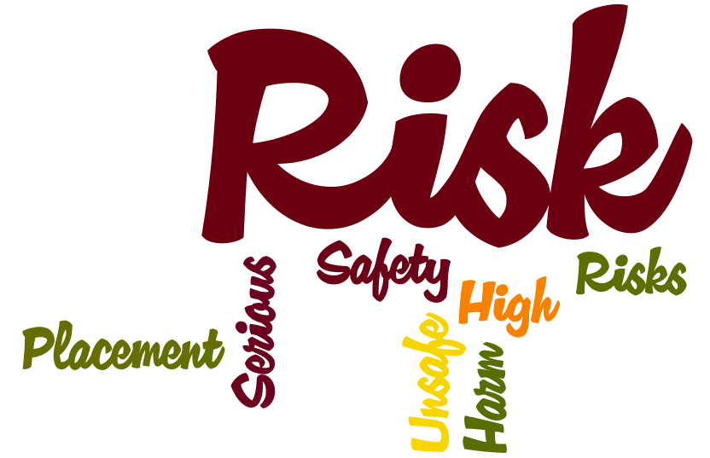
Pre-Service Curriculum Module 8.6.3

Slide 58
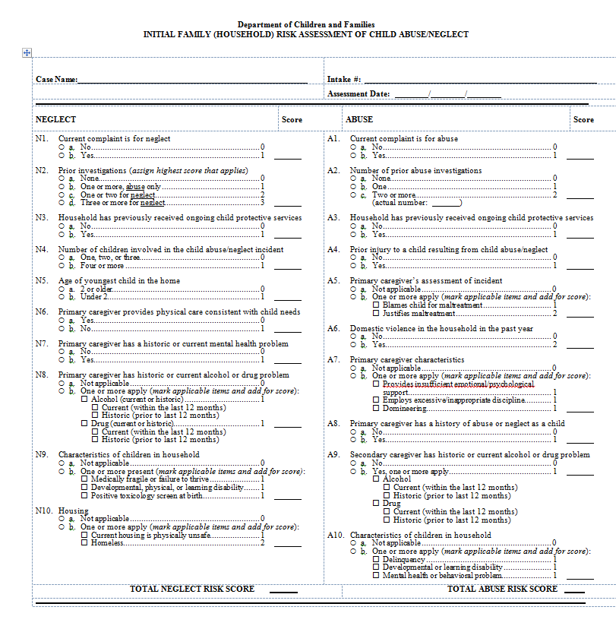
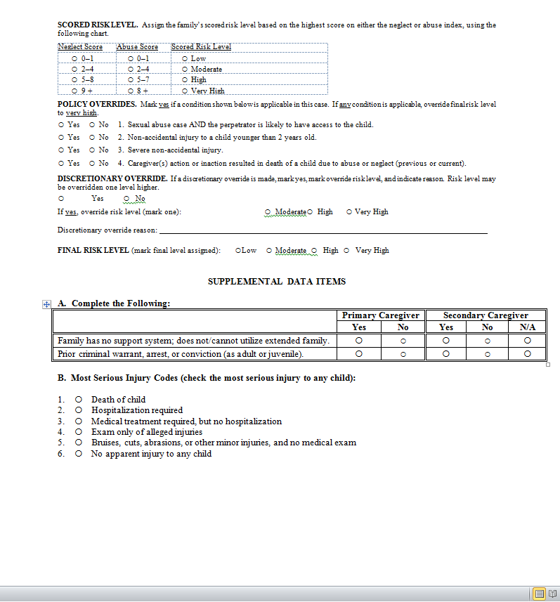
Actuarial Tool to Assess Families at Risk
Pre-Service Curriculum Module 8.6.4

