Slide 1
Module 1
The Child Welfare System
Notes:
1.0.1

Slide 2

Agenda
Unit 1.1: Legal Foundations
Unit 1.2: Guiding Principles
Unit 1.3: Roles and Responsibilities
Unit 1.4: Ethical Requirements of the Child Welfare Professional
Unit 1.5: Tools and Resources
Notes:
1.0.2

Slide 3

Unit 1.1
Legal Foundations
Notes:
1.1.1

Slide 4

Learning Objectives
Notes:
1.1.2

Slide 5

Activity
Ice Breaker
Notes:
1.1.3

Slide 6

Family Secrets
Notes:
1.1.4

Slide 7
“The battered-child syndrome, a clinical condition in young children who have received serious physical abuse, is a frequent cause of permanent injury or death.”
Battered Child Syndrome, by Dr. Kempe, 1962
Notes:
1.1.5

Slide 8
Dr. Kempe’s Findings 1962
Many times, injuries to children could not possibly have been caused the way they were explained.
These injuries were inflicted by parents.
Coined the term “Battered child”
Advocated for diagnoses of child
Argued that child abuse was a reportable disease
Notes:
1.1.6

Slide 9
Social Security Act
By 1965, all states had enacted child abuse reporting laws.
Child Abuse Prevention and Treatment Act (CAPTA), 1974.
By July 1, 1975, Child Protective Services were included as a component of public welfare programs.
National Clearinghouse on Child Abuse and Neglect Information
Notes:
1.1.7

Slide 10
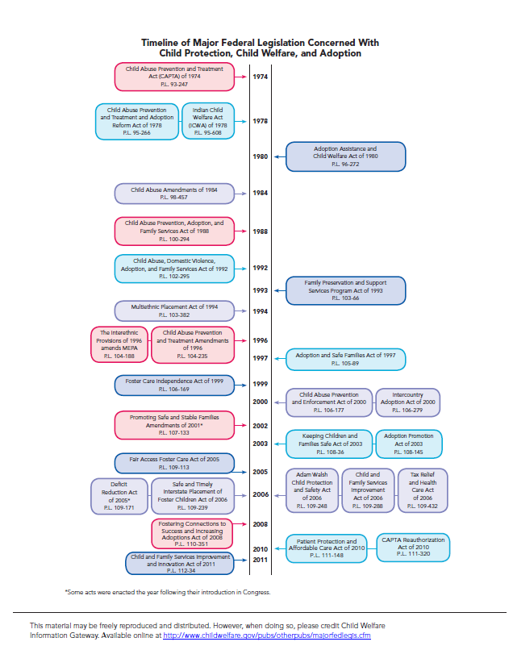
1974 CAPTA
Slide A Short History of Child Protection in America, John E.B. Myers, Professor and Scholar, University of the Pacific, McGeorge School of Law.
of Fed legislation timeline with an arrow pointing to CAPTA 1974
Notes:
1.1.8

Slide 11
Operating
Procedures
Florida Statutes Chapter 39
US Constitution
FL Administrative Code / Rules of Juvenile Procedure
Notes:
1.1.9

Slide 12

Due Process
Notes:
1.1.10

Slide 13
Due Process
Due Process is a guarantee that all legal proceedings will be fair and one will be given notice of proceedings and an opportunity to be heard before one’s life, liberty or property is taken away.
Notes:
1.1.11

Slide 14
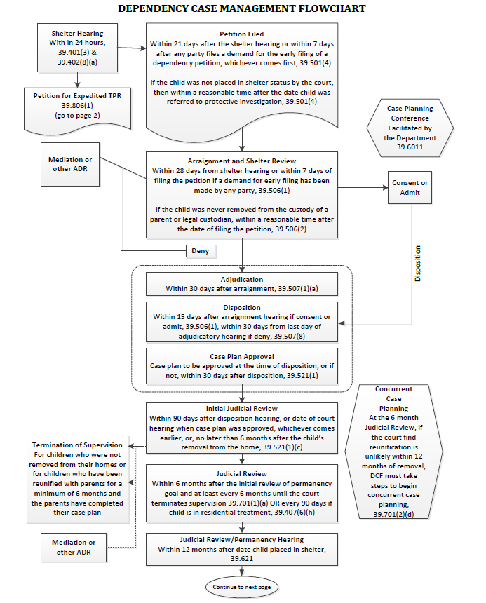
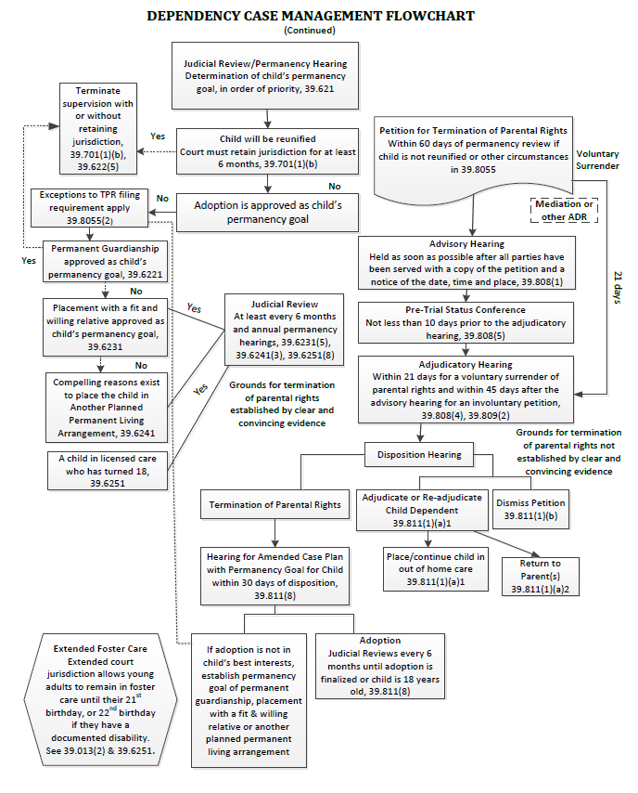
Dependency Case Management Flowchart located in your Resource Guide
Notes:
1.1.12

Slide 15
Least Intrusive
“Least intrusive” refers to intervening to protect a child in ways that produce the least interference with family unity and privacy, yet assure child safety. Even in the best of circumstances, child welfare is a governmental, non-voluntary intervention. It creates an interruption in a family’s life - to its autonomy and to caregiver empowerment.
Notes:
1.1.13

Slide 16
Reasonable Efforts
…before a child is removed from home, all reasonable actions have been taken by the child welfare professional to prevent that removal from occurring.
Notes:
1.1.14

Slide 17
Permanency Planning
…ensure that children get resolution to their need for safety and a permanent family to raise them.
Notes:
1.1.15

Slide 18
“A certified professional shall not in any way participate in discrimination on the basis of race, color, sex, sexual orientation, age, religion, national origin, socio-economic status, political belief, psychiatric or psychological impairment, physical disability, or the amount of previous therapeutic or treatment occurrences.”
Notes:
1.1.16

Slide 19
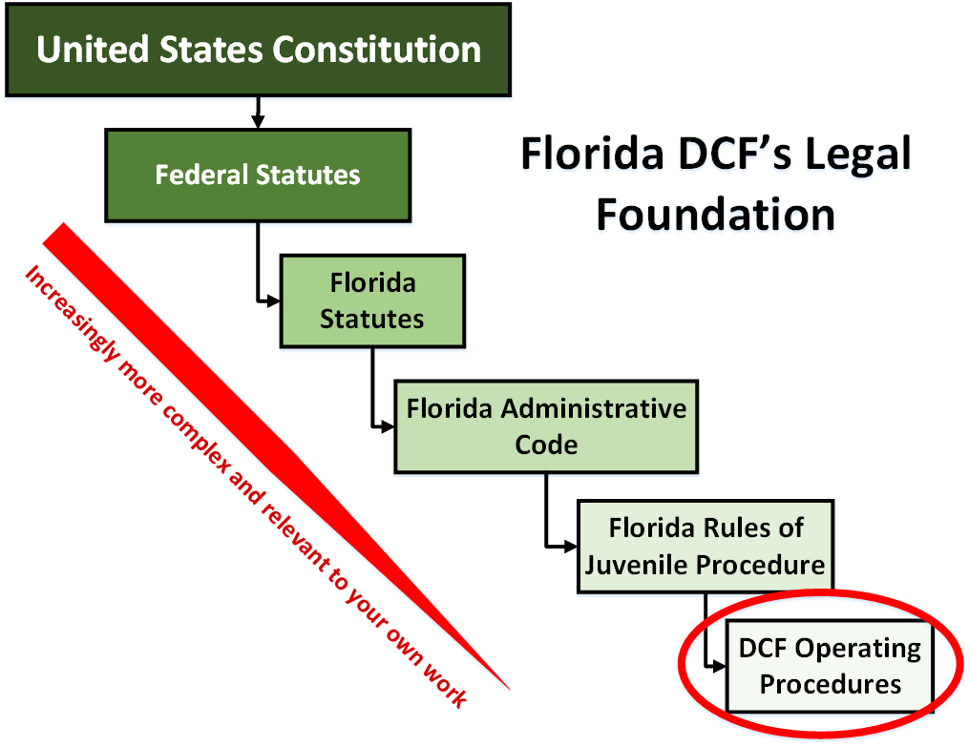
Notes:
1.1.17

Slide 20
Rules of Juvenile Procedure
The Rules of Juvenile Procedure govern how attorneys within DCF’s Children’s Legal Services operate and include:
An explanation of how the laws can be translated into court practice.
Guidance for attorneys on courtroom procedures in dependency cases.
An explanation of the purposes of and the requirements for court hearings.
Instruction regarding content required within petition/court documents.
Notes:
1.1.18

Slide 21
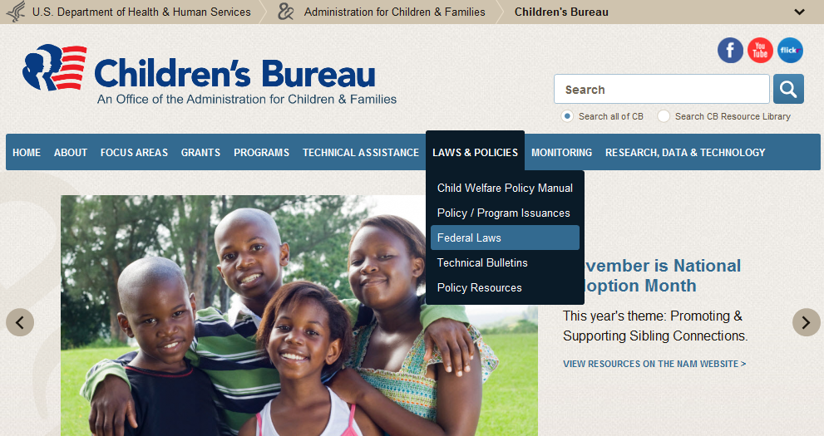
Children’s Bureau
Notes:
1.1.19

Slide 22
Activity
Federal Statutes Impacting Your Work
Notes:
1.1.20

Slide 23
Five Federal Statutes Important In Your Work
Child Abuse Prevention and Treatment Act (CAPTA)
The Adoption and Safe Families Act of 1997 (ASFA)
Interstate Compact on the Placement of Children (ICPC)
The Indian Child Welfare Act (ICWA)
Multi Ethnic Placement Act (MEPA)
Notes:
1.1.21

Slide 24
Unit 1.2
Guiding Principles
Notes:
1.2.1

Slide 25
Learning Objectives
Notes:
1.2.2

Slide 26
Our Purpose
Identify whether a child is in danger or at risk of future harm.
When the child is in danger, determine what must be done to:
  protect the child
  provide reasonable efforts to strengthen the caregiver protective capacities that led to the child safety issues, and
When reasonable efforts to strengthen caregiver protective capacities have occurred and do not result in sufficient change, work to achieve another permanency goal for the child.
Notes:
1.2.3

Slide 27
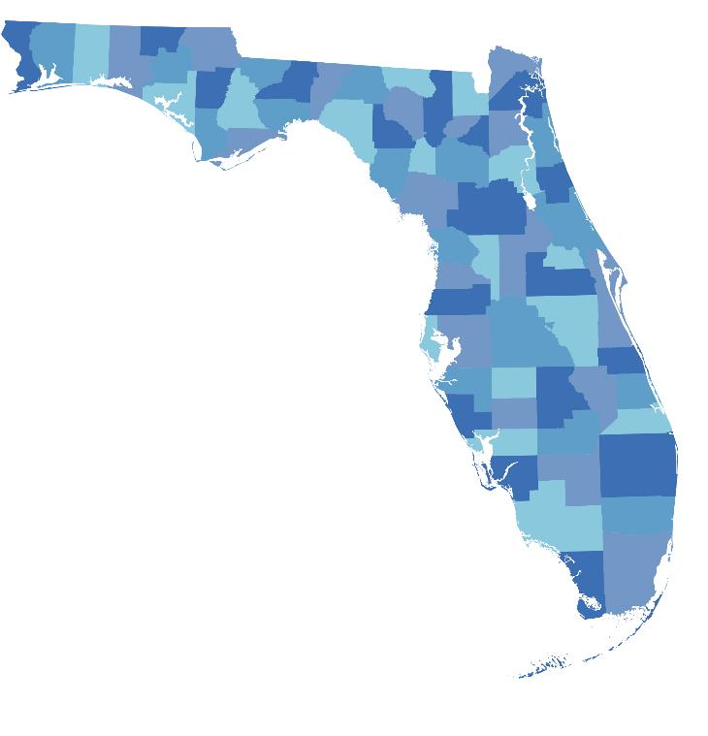
The State’s Protective Role with Children
Notes:
1.2.4

Slide 28

Child Protective Services (CPS): Principle 1
The health and safety of the children served shall be of paramount concern.
Notes:
1.2.5

Slide 29

CPS: Principle 2
The prevention and intervention by the child protection system should engage families in constructive, supportive and non-adversarial relationships.
Notes:
1.2.6

Slide 30
CPS: Principle 3
The prevention and intervention should intrude as little as possible into the life of the family, be focused on clearly defined objectives, and keep the safety of the child or children as the paramount concern.
Notes:
1.2.7

Slide 31

CPS: Principle 4
The prevention and intervention should be based upon outcome evaluation results that demonstrate success in protecting children and supporting families.
Notes:
1.2.8

Slide 32
Unit 1.3
Roles and Responsibilities
Notes:
1.3.1

Slide 33
Learning Objectives
Notes:
1.3.2

Slide 34
Activity
Child Welfare Roles
FAMILY
Child Protective Investigator
Guardian Ad Litem
Case Manager
Foster Parent
Notes:
1.3.3

Slide 35
Unit 1.4
Ethical Requirements of the
Child Welfare Professional
Notes:
1.4.1

Slide 36
Learning Objectives
Notes:
1.4.2

Slide 37

Florida’s Child Welfare
Guiding Principles
Notes:
1.4.3
Key Points:
These four principles include:
The health and safety of the children served shall be of paramount concern.
The prevention and intervention should engage families in constructive, supportive, and non-adversarial relationships.
The prevention and intervention should intrude as little as possible into the life of the family, be focused on clearly defined objectives, and take the most parsimonious path to remedy a family’s problems.
The prevention and intervention should be based upon outcome evaluation results that demonstrate success in protecting children and supporting families.

Slide 38
Florida’s Code of Ethics
Confidentiality Laws
Conflict of Interest
Derogatory Language
Dishonesty, Fraud or Deception
Falsification of Records
Exploitation of Clients/Sexual Relationships
Impairment
Misrepresentation/Misuse of Position
Unethical Conduct of Colleagues
Notes:
1.4.4

Slide 39
Activity
Essence
Notes:
1.4.5

Slide 40
Activity
Identifying Ethical Violations
Notes:
1.4.6

Slide 41
Unit 1.5
Tools and Resources
Notes:
1.5.1

Slide 42
Learning Objectives
Notes:
1.5.2

Slide 43
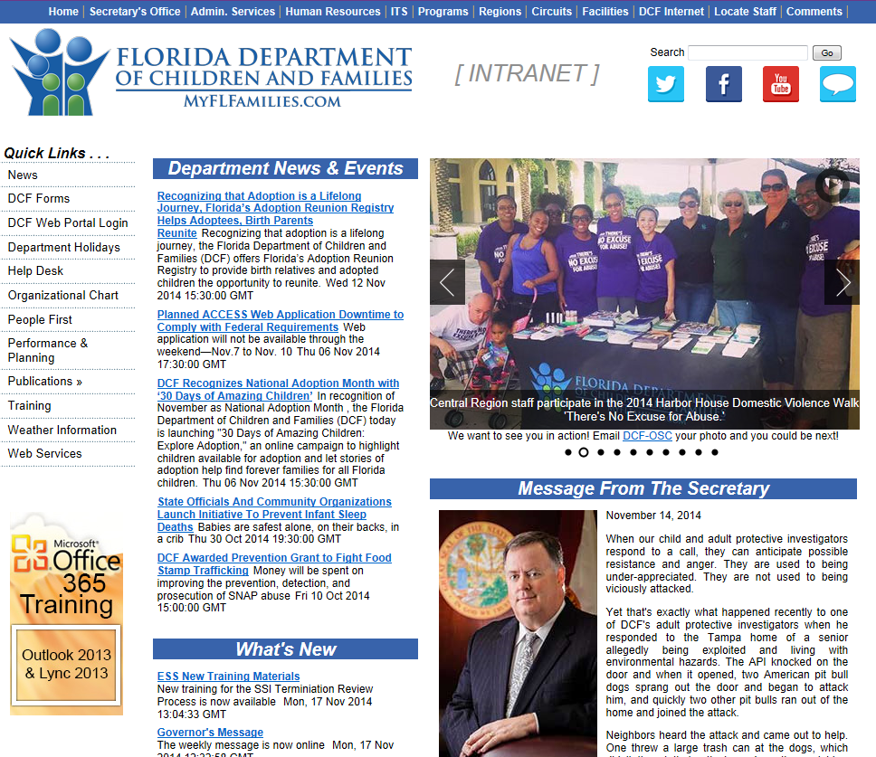
http://eww.dcf.state.fl.us/
Notes:
1.5.3

Slide 44
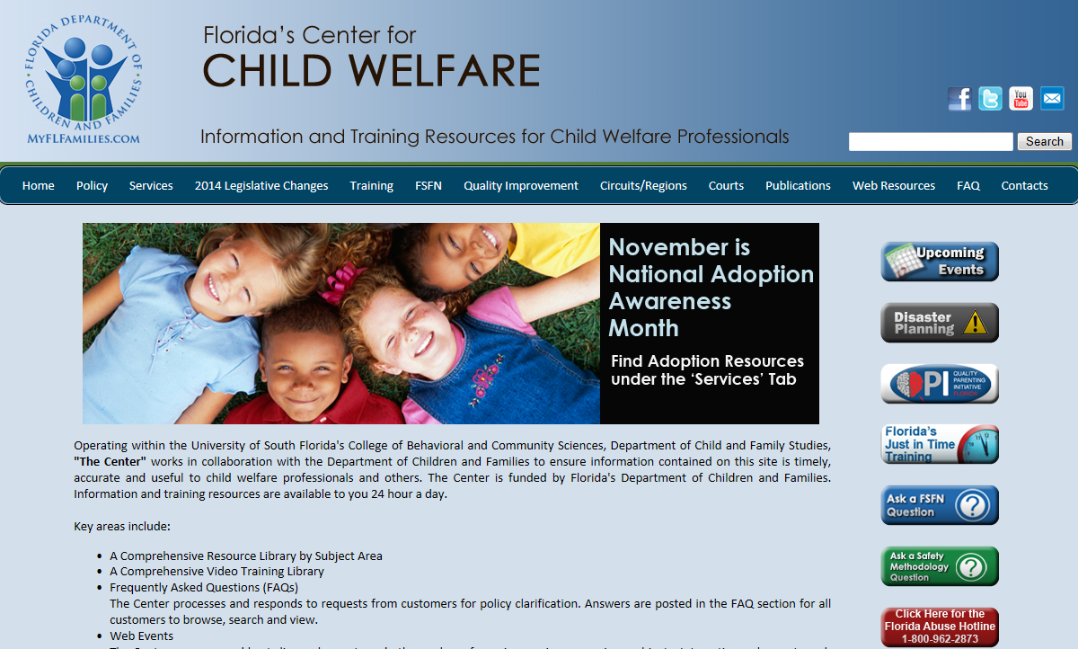
http://www.centerforchildwelfare.org/
Notes:
1.5.4

Slide 45

http://flcertificationboard.org/
Notes:
1.5.5

Slide 46

Great Work!
Notes:
1.5.6

