Slide 1

Communication Skills Lab 4
Interviewing Children
Notes:
1.0.1

Slide 2
Day 1 Agenda
Debrief field observations.
Describe foundational concepts of interviewing children.
Identify how to conduct language assessments of children.
Identify and practice interviewing questions and solutions for children at different stages of language development.
Core Pre-Service Curriculum – Lab 4.0.2
Notes:
1.0.2

Slide 3
Day 2 Agenda
Describe foundational concepts of interviewing children for maltreatment disclosures and safety assessment.
Identify and practice interviewing questions to learn about maltreatment and safety.
Prepare for field observation and practice of child interviewing skills.
Core Pre-Service Curriculum – Lab 4.0.3
Notes:
1.0.2

Slide 4
Lab Unit 4.1
Debrief Field Observations of Exploring and Focusing Skills
Core Pre-Service Curriculum – Lab 4.1.1
Notes:
1.1.1

Slide 5
Learning Objectives
Discuss the shadowing experience.
  What worked well
  What was a challenge
Discuss exploring and focusing skills observed.
  Examples of effective uses
  Missed opportunities
Beyond exploring and focusing skills, describe other skills noticed.
Core Pre-Service Curriculum – Lab 4.1.2
Notes:
9.2.16

Slide 6
Effective Interview Openings
Respectful greeting
Purpose explained
Personal expression offered
Immediate concerns addressed
Any suggested improvements
Core Pre-Service Curriculum – Lab 4.1.3

Slide 7
Information Gathering
Appropriate mix of exploring skills
Appropriate mix of focusing skills
Examples of:
Conversational flow to interview?
  Reframes
  Positive feedback
  Developing discrepancy
Suggested improvements?
Core Pre-Service Curriculum – Lab 4.1.4

Slide 8
Lab Unit 4.2
Power of Simplicity
Core Pre-Service Curriculum – Lab 4.2.1
Notes:
9.2.15

Slide 9
Learning Objectives
Identify different types and purposes of child interviews.
Explain the stages of a child interview.
Describe impact of child characteristics on interview approach.
Discuss appropriate and inappropriate question types for children.
Explain the specific “instructions” for children that are provided in child interviews.
Core Pre-Service Curriculum – Lab 4.2.2

Slide 10
Translate this…
A research team proceeded towards the apex of a natural geologic protuberance, the purpose of their expedition being the procurement of a sample of fluid hydride of oxygen in a large vessel, the exact size of which was unspecified. One member of the team precipitously descended, sustaining severe damage to the upper cranial portion of his anatomical structure; subsequently the second member of the team performed a self rotational translation oriented in the same direction taken by the first team member."
Core Pre-Service Curriculum – Lab 4.2.3

Slide 11
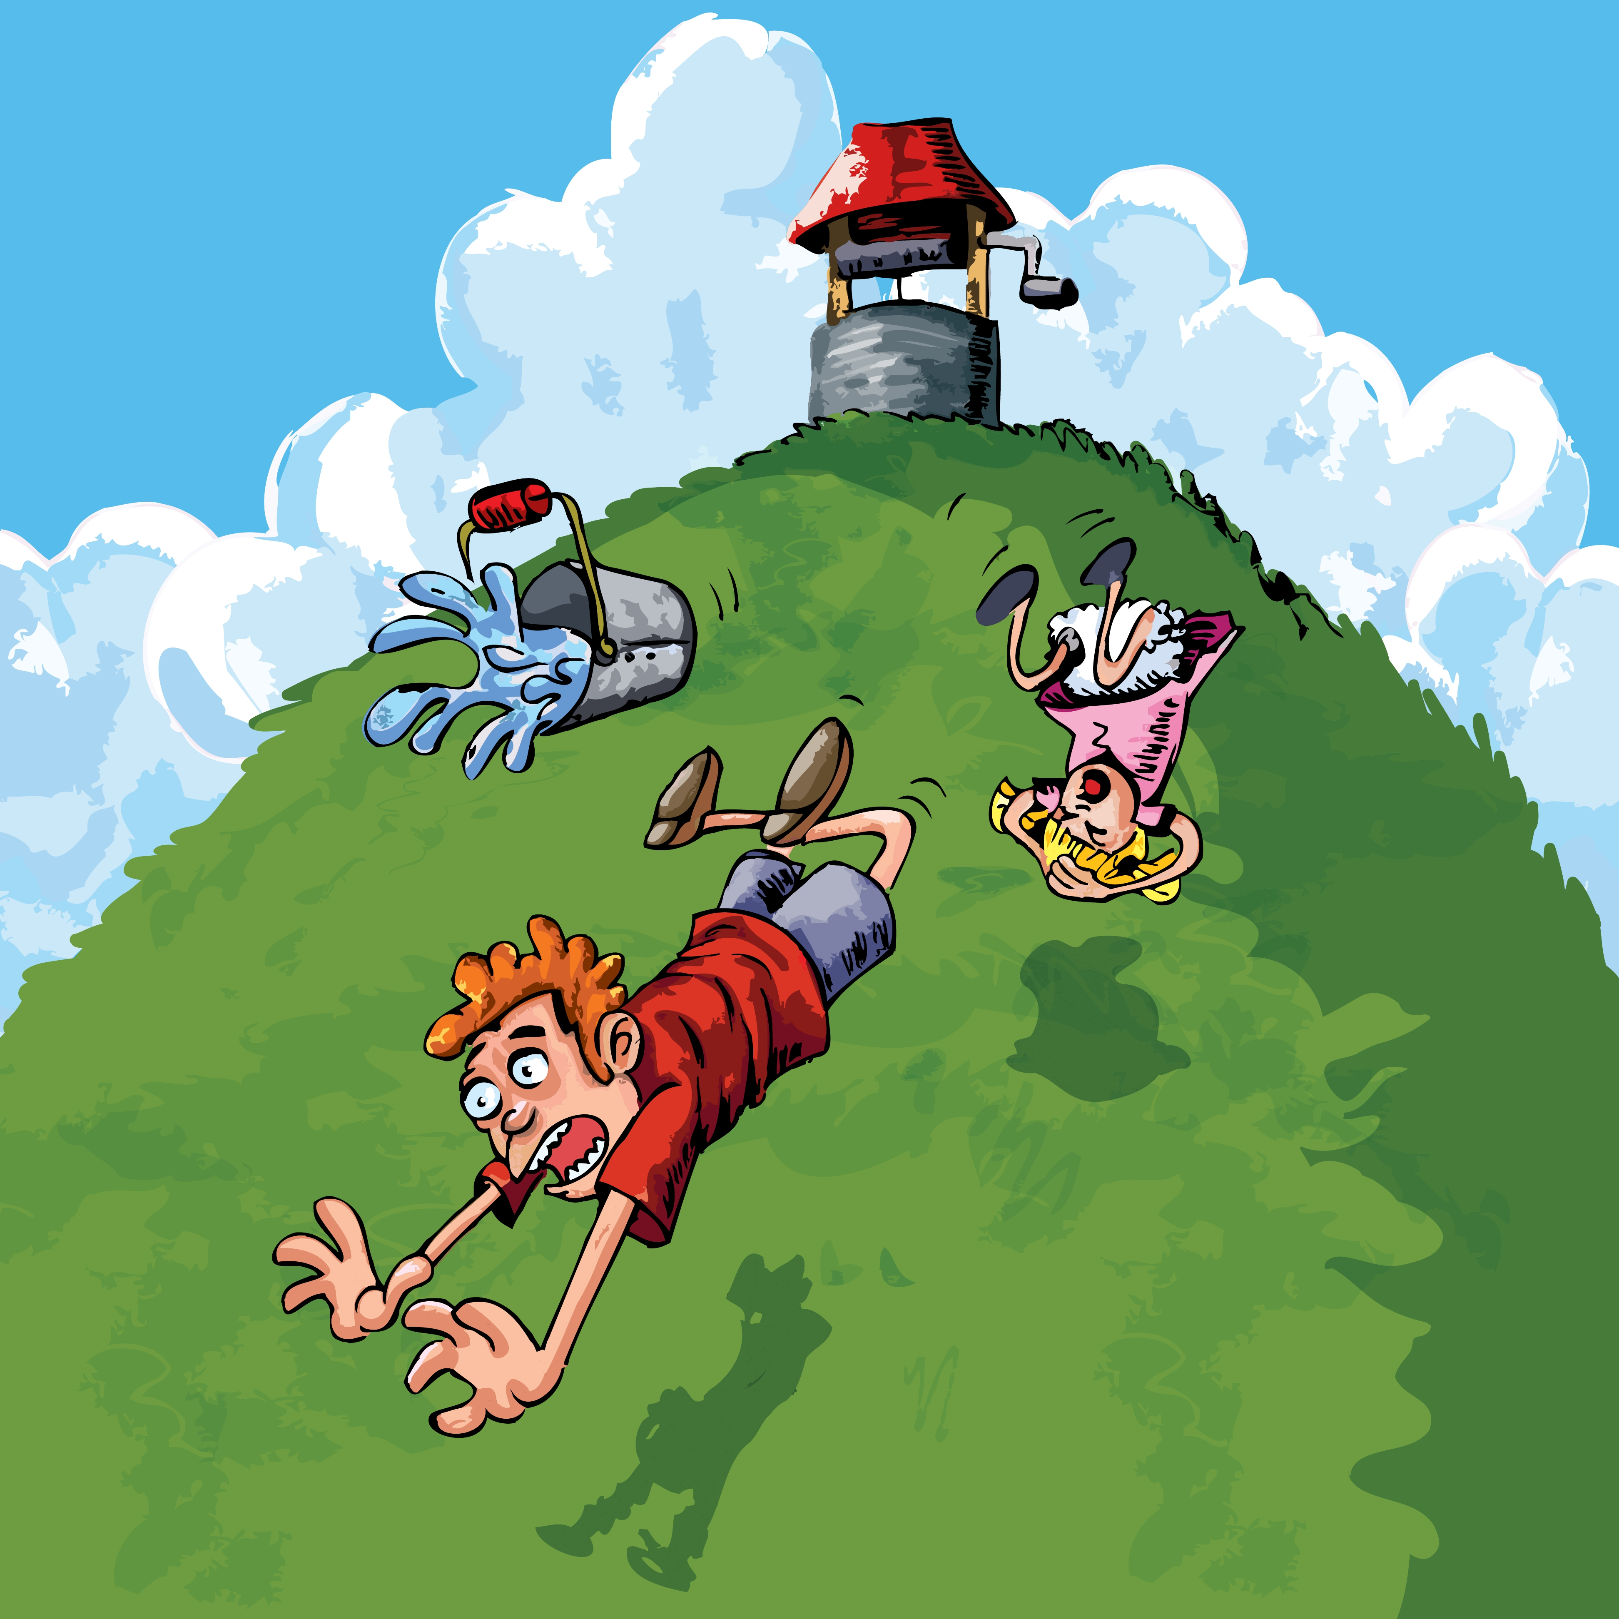
Jack and Jill went up the hill to fetch a pail of water,
Jack fell down and broke his crown
and Jill came tumbling after.
Core Pre-Service Curriculum – Lab 4.2.4

Slide 12
Child Interview Types
Investigative Interview
  Child Protection Investigator
Child Safety & Well-being Interview
  Case Manager
  In-home, Foster Care
  Adoptions
  Independent Living
Core Pre-Service Curriculum – Lab 4.2.5

Slide 13

“She understands a lot, she just can’t talk yet.”
Comprehension precedes language.
Core Pre-Service Curriculum – Lab 4.2.6

Slide 14
Child Interview Types
Forensic Interview
  Child Protection Teams
  Child Advocacy Center
  Law Enforcement
Therapeutic Interview
  Behavioral Health Professionals
Core Pre-Service Curriculum – Lab 4.2.7

Slide 15
Engagement Skills Continuum
Core Pre-Service Curriculum – Lab 4.2.8

Slide 16

Lab Activity 1:
Ten Step Investigative Interview
Part 1
(U-tube clip to be embedded week of 1-19-15)
Core Pre-Service Curriculum – Lab 4.2.9
Notes:
9.1.8

Slide 17
Ask open ended questions
Tell me…
What
Who
When
Where
How
Avoid…
Did
Was
Can you tell me
Do you know
OR
Core Pre-Service Curriculum – Lab 4.2.10

Slide 18
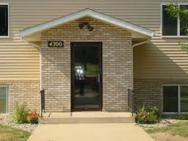
Opening Phase of Interview
Core Pre-Service Curriculum – Lab 4.2.11

Slide 19
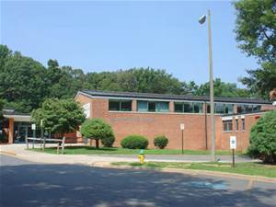
Interviews at school
Find quiet, private setting
Wait for natural break in child’s schedule
Help child regain composure before going back to class
Core Pre-Service Curriculum – Lab 4.2.12

Slide 20

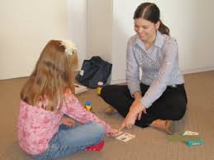
Non-threatening, empathetic style
OR
Core Pre-Service Curriculum – Lab 4.2.13

Slide 21
Explaining Interview Purpose
Introduce yourself and your role
Explain purpose of interview
Address child concerns/misconceptions
Discuss limits of confidentiality
Core Pre-Service Curriculum – Lab 4.2.14

Slide 22
Interviewing Essentials
Never lie to a child
Never promise a child you will keep them safe
Determine who else knows about the maltreatment
Plan with child as to parent or other caregiver responses to disclosures
Core Pre-Service Curriculum – Lab 4.2.15

Slide 23




Decrease Child Stress Level
Core Pre-Service Curriculum – Lab 4.2.16

Slide 24
Lab Activity 2:
Ten Step Investigative Interview, The Instructions
(U-tube clip to be embedded week of 1-19-15)
Core Pre-Service Curriculum – Lab 4.2.17
Notes:
9.1.8

Slide 25
Instructions for Child Interviews
1. DON’T KNOW instruction
2. DON’T UNDERSTAND instruction
3. YOU’RE WRONG instruction
4. IGNORANT INTERVIEWER instruction
5. PROMISE TO TELL THE TRUTH instruction
Core Pre-Service Curriculum – Lab 4.2.18

Slide 26
Lab Activity 3:
Demonstrate use of child interview instructions.
Core Pre-Service Curriculum – Lab 4.2.19
Notes:
9.1.8

Slide 27

Tips To Consider When Talking With A Child In Distress
Attending behaviors
  Be attuned to child
  Be self-aware
Right setting for interview
Use of drawings, other props
Don’t make promises you can’t keep
Core Pre-Service Curriculum – Lab 4.2.20

Slide 28
Lab Unit 4.3
Language Assessment and Narrative Practice
Core Pre-Service Curriculum – Lab 4.3.1
Notes:
9.2.15

Slide 29
Learning Objectives
Explain the suggestibility of children.
Describe the instructions for child interviews from the “10 step” process.
Discuss narrative practice (helping children tell their story).
Explain the use of narrative practice to assess language skills.
Describe and demonstrate language solutions.
Core Pre-Service Curriculum – Lab 4.3.2

Slide 30

Suggestibility
Unintended interviewer influence
Coaching or shaping by parent/caregiver
Coercion not to tell
Core Pre-Service Curriculum – Lab 4.3.3

Slide 31
Lab Activity 4:
Ten Step Investigative Interview,
Narrative Practice
(U-tube clip to be embedded week of 1-19-15)
Core Pre-Service Curriculum – Lab 4.3.4
Notes:
9.1.8

Slide 32
Like to do/Don’t like to do
First, I’d like you to tell me about things you LIKE to do.
Follow up with TELL ME MORE questions. e.g., “You said you like to play soccer. Tell me more about soccer.”
Now tell me about the things you DON’T LIKE to do.
Follow up with TELL ME MORE questions.
Core Pre-Service Curriculum – Lab 4.3.5

Slide 33

Frames
Let’s child know the topic
Keeps interview focus
Redirect a child’s focus
Can go back to it
Core Pre-Service Curriculum – Lab 4.3.6

Slide 34

Tell me about your birthday!
“Now tell me about your birthday. Tell me everything that happened.”
Follow-up with “What happened next?”
“You said you played in the bouncy. What did you do next?”
Core Pre-Service Curriculum – Lab 4.3.7

Slide 35
Narrative: Helping the child tell their story
Who are characters and where does it take place?
What made event come about?
What happened?
What were the motivations/goals of main characters?
What were the attitudes/emotions of main characters?
What were the consequences and conclusion?
Core Pre-Service Curriculum – Lab 4.3.8

Slide 36
Language Assessment
Vocabulary
Comprehension
Memory
Attention span
Core Pre-Service Curriculum – Lab 4.3.9

Slide 37

Pre-School Age
(3-5 years)
Attributes:
Honesty
Lack of embarrassment
May enjoy adult attention
Lack of inhibition about sexual topics
Core Pre-Service Curriculum – Lab 4.3.10

Slide 38
Language Challenges:
Pre-School Age
Literal and concrete
Reluctant to admit they don’t understand
Yes bias
Early language development
Can recite but don’t know (e.g. numbers)
Kinship
Core Pre-Service Curriculum – Lab 4.3.11

Slide 39
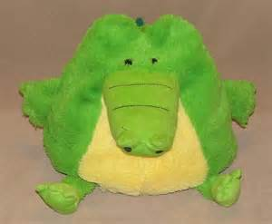
Is this alligator pretend or real?
Core Pre-Service Curriculum – Lab 4.3.12

Slide 40
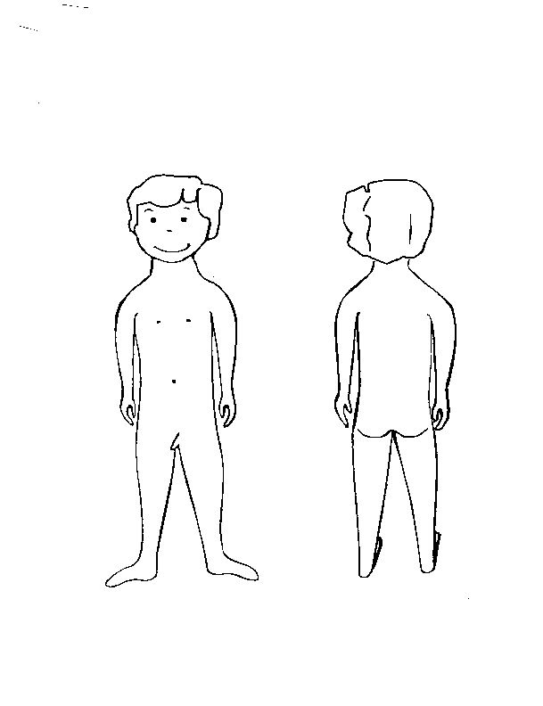
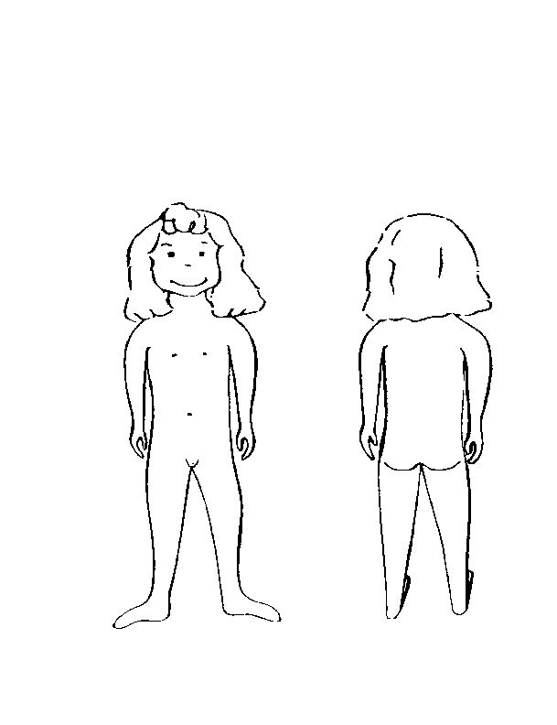
Anatomical Diagrams
Children’s Advocacy Center, of the Thirteenth Judicial Circuit Court,
Tampa, Florida
Core Pre-Service Curriculum – Lab 4.3.13

Slide 41
In their own words…
Pee pee
Pocket book
ding dong
Hunching me
boobs
Front-butt
Rub my privacy
puchina
chest
stick
Licked my coochie
bottom
Fingering me
Kitty-cat
back private
wee wee
messin with me
booty
hose
Doing it
Core Pre-Service Curriculum – Lab 4.3.14
Notes:
Don't change their language. Write it down the way they said it. If they said "it spit at me" or "it felt like fire", do not summarize their statement to say "the child said it hurt". We loose valuable information in the process.

Slide 42
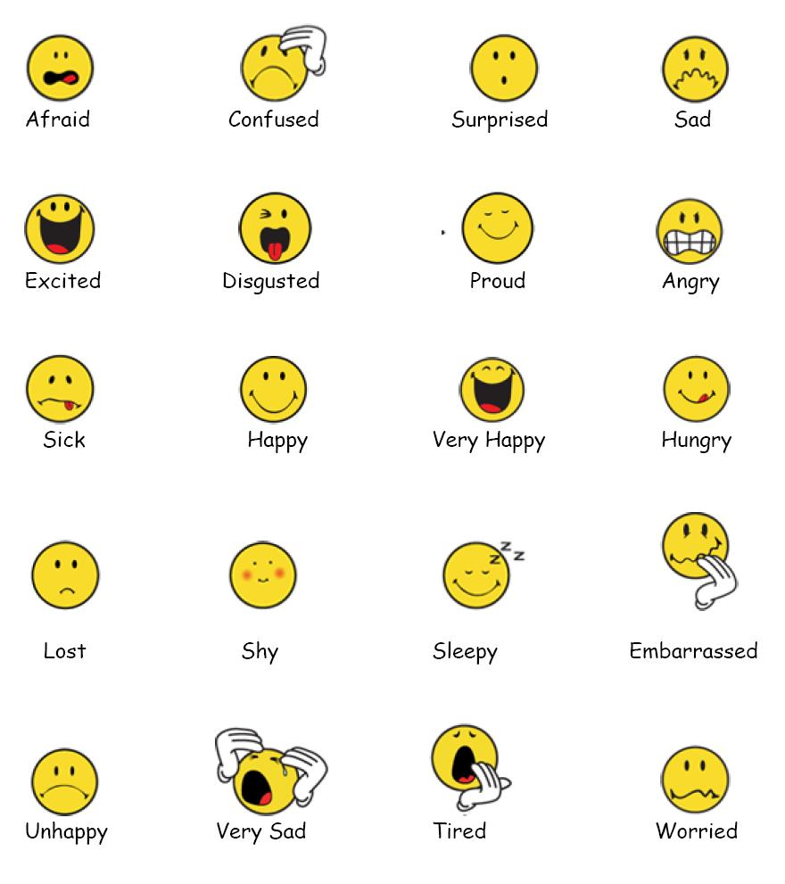
Understanding of feelings
Core Pre-Service Curriculum – Lab 4.3.15

Slide 43

Language Challenges:
Pre-School Age, continued
Pronouns
he/she
we/they
this/that/it
here/there
Core Pre-Service Curriculum – Lab 4.3.16

Slide 44
Language Challenges:
Pre-School Age, continued
Correct use of Prepositions
  Inside/outside
  Behind
  Between
Understanding of words that are “absolutes”
  always/never
  anyone/someone
  any/anything/any where
  Ever
Distinction between ask and tell
Core Pre-Service Curriculum – Lab 4.3.17

Slide 45
Where is my pen?
Can you put it on top of the sofa?
Can you put it under the sofa?
Can you put behind the sofa?
----------------------------------------------------
Where is it now? (on)
Where is it now? (under)
Where is it now? (in)
Core Pre-Service Curriculum – Lab 4.3.18

Slide 46
Language Assessment:
Pre-School Age
Clarity of speech and language use
  --Vocabulary -- Sentences (short, long)
Concepts (Who, what, where)
Attention span
Memory
Colors, numbers
Prepositions (On, Under, In, etc.)
Core Pre-Service Curriculum – Lab 4.3.19

Slide 47

Other ways to confuse a child…
More than one idea in a sentence
Asking a question that requires advanced mastery of concepts
Complex negation
Asking “WHY?”
Core Pre-Service Curriculum – Lab 4.3.20

Slide 48
Lab Activity 5:
Demonstrating Language Solutions
Core Pre-Service Curriculum – Lab 4.3.21
Notes:
9.1.8

Slide 49
Lab Activity 6:
What to ask a Four-Year-Old
Core Pre-Service Curriculum – Lab 4.3.22
Notes:
9.1.8

Slide 50

Language Skills:
Latency Age (6-11)
More developed language
Increasingly accurate perception of reality
Developing logic and reasoning
More able to:
  Sustain attention and focus on a task
  Think about problem solving
  Be aware of self
Core Pre-Service Curriculum – Lab 4.3.23

Slide 51
Challenges:
Latency Age (6-11)
Significant differences in maturity
Thinking is still concrete
Experience embarrassment/shame/guilt
Moral responsibility
Loyalty to family
Developing memory strategies
Core Pre-Service Curriculum – Lab 4.3.24

Slide 52
Language Assessment:
Latency Age (6-11)
Knowledge of DOB, address, city/state of residence, kinship
Style of speech, including affect
Narrative details & vocabulary
Understanding of time
Ability to describe feelings
Core Pre-Service Curriculum – Lab 4.3.25

Slide 53
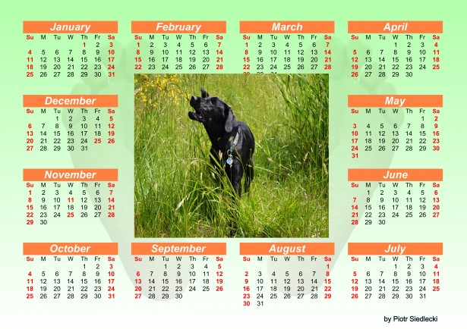

Understanding of Time
Core Pre-Service Curriculum – Lab 4.3.26

Slide 54
Understanding of feelings
Core Pre-Service Curriculum – Lab 4.3.27

Slide 55
Lab Activity 7:
What to ask a Nine-Year-Old
Core Pre-Service Curriculum – Lab 4.3.28
Notes:
9.1.8

Slide 56

Adolescents (12-18)
Core Pre-Service Curriculum – Lab 4.3.29

Slide 57
Interviewing Considerations for Adolescents
Adolescents may have a gender preference for interviewer
Allow the victim to control pace if at all possible
Acknowledge disclosure may make things worse before they get better
Recognize consensual sexual history confuses the issue
Recognize they may be younger emotionally than they appear physically
Accept their need for accountability
Core Pre-Service Curriculum – Lab 4.3.30

Slide 58
Lab Activity 8:
What to ask a fifteen-year old
Core Pre-Service Curriculum – Lab 4.3.31
Notes:
9.1.8

Slide 59
Child Interviewing Day 2
Lab Unit 4.4
Interviewing Children to Learn about Maltreatment and Safety
Core Pre-Service Curriculum – Lab 4.4.1
Notes:
1.1.1

Slide 60
Day 2 Agenda
Describe foundational concepts of interviewing children for maltreatment disclosures and safety assessment.
Identify and practice interviewing questions to learn about maltreatment and safety.
Prepare for field observation and practice of child interviewing skills.
Core Pre-Service Curriculum – Lab 4.4.2
Notes:
1.0.2

Slide 61
Learning Objectives
Learn how language assessment informs the interview questions.
Learn effective question styles, content and methods for eliciting factual information.
  Child’s names for body parts
  Child’s understanding of types of touching
  Safe house drawings
Explain the purpose of forensic interviews and how to best support a forensic interview.
Describe the main errors in interviewing children.
Identify and demonstrate appropriate interviewing questions with children.
Core Pre-Service Curriculum – Lab 4.4.3

Slide 62
Child Interview Opening
Core Pre-Service Curriculum – Lab 4.4.4

Slide 63
Child Interview- Gathering Information
Core Pre-Service Curriculum – Lab 4.4.5

Slide 64
Lab Activity 9:
Asking child about adult functioning, parenting and discipline
Core Pre-Service Curriculum – Lab 4.4.6
Notes:
9.1.8

Slide 65
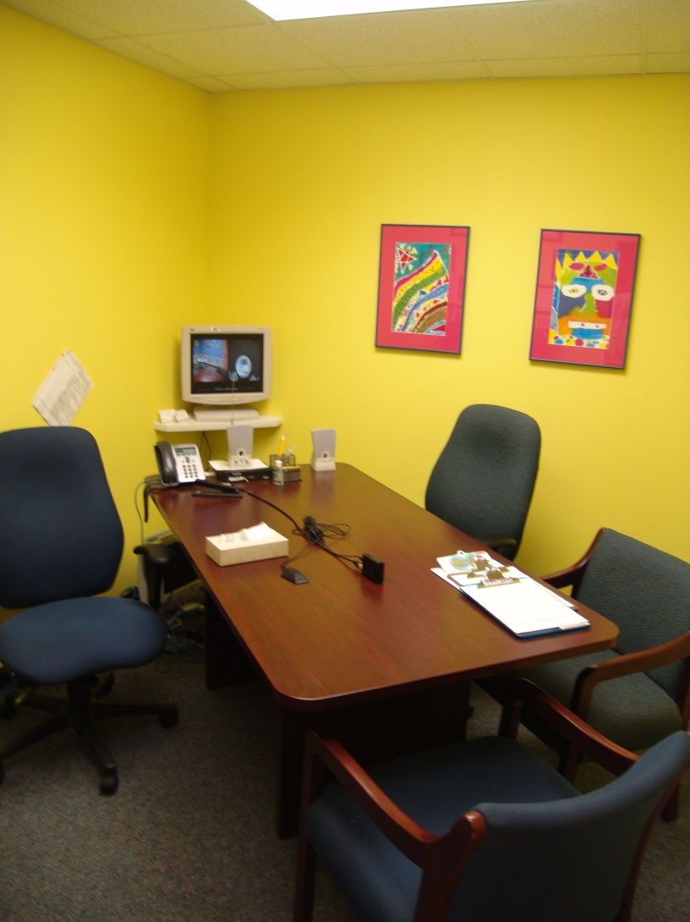
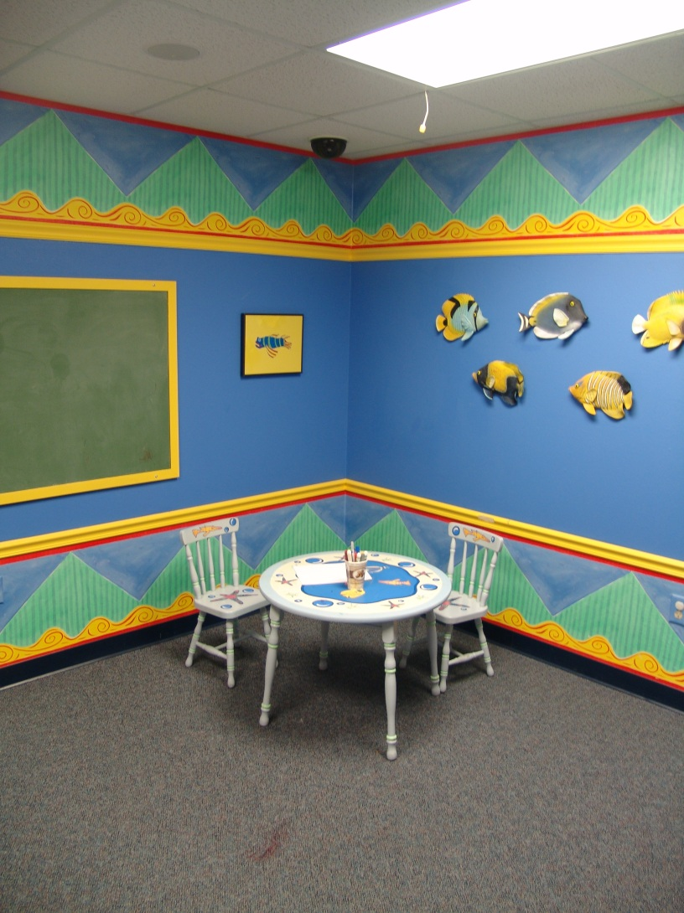
Forensic Interview Rooms:
Pre-Interview Room Interview Room
Children’s Advocacy Center, of the Thirteenth Judicial Circuit Court, Tampa, Florida
Core Pre-Service Curriculum – Lab 4.4.7

Slide 66
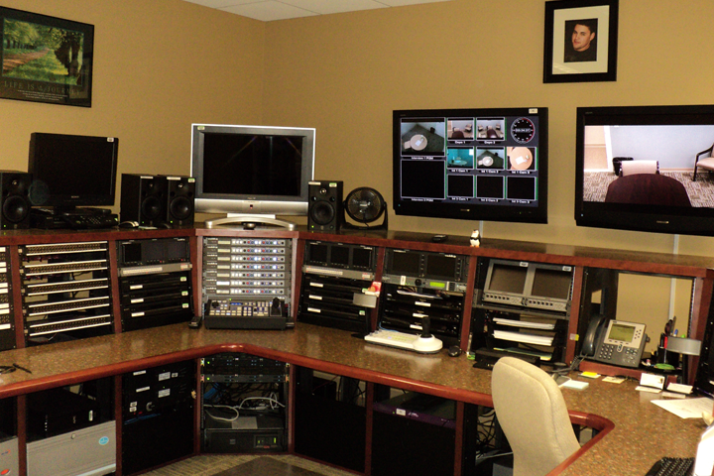
Forensic Interview Recording Room
Children’s Advocacy Center, of the Thirteenth Judicial Circuit Court,
Tampa, Florida
Core Pre-Service Curriculum – Lab 4.4.8

Slide 67
Learning about maltreatment
Contributes information to know if child is safe or not safe
Provides legal evidence for sheltering a child (probable cause)
Provides legal evidence for dependency petition (preponderance of evidence)
As a “First Responder,” your performance is critical to the rest of any criminal investigation
Core Pre-Service Curriculum – Lab 4.4.9

Slide 68
“Ten Step Investigative Interview,” Last four….
7. ALLEGATION
8. ALLEGATION FOLLOW UP
9. Follow up with TELL ME MORE and WHAT HAPPENED NEXT
10. MULTIPLE INCIDENTS
Thomas D. Lyon, J.D., Ph.D. tlyon@law.usc.edu © 2005 (version 2)
Core Pre-Service Curriculum – Lab 4.4.10

Slide 69

Memory research
Children have memories of events
Specific questions yield information
Errors in memory increase with the wrong questions about details
Core Pre-Service Curriculum – Lab 4.4.11

Slide 70
Guidelines for Age-Appropriate
Interview Questions
Age | Who | What | Where | When | # of Times | Circumstance
3
4 - 6
7 - 8
9 - 10
11 - 12
Children’s Advocacy Center, of the Thirteenth Judicial Circuit Court,
Tampa, Florida
Core Pre-Service Curriculum – Lab 4.4.12

Slide 71
Appropriate Cues vs. Leading Questions
Appropriate Cue
Tell me how your arm got broken.
Leading Question
Your dad really didn’t break your arm, did he?
Appropriate Cue
I am wondering if there are secrets in your family?
Leading Question
There are secrets in your family, aren’t
there?
Core Pre-Service Curriculum – Lab 4.4.13

Slide 72
Child Sexual Abuse Needs to Be Explored When
Child may have made intentional disclosure before interview
Reporter may have concerns about sexualized behaviors, no disclosure
Perpetrator violence towards adult spouse/partner
Child lives with other child(ren) who have been sexually abused
Core Pre-Service Curriculum – Lab 4.4.14

Slide 73
Questions About Possible Sexual Abuse
Use child’s drawings and words from language assessment
Conduct “Touch Inquiry”
  Ask questions to clarify whether any not ok touches have happened
Who, what, where, when…
Obtain sensory details
Core Pre-Service Curriculum – Lab 4.4.15

Slide 74
Touch Inquiry
“Where is it ok?”
Establishes where the child believes it is ok and not ok to get touches
Caution:
“OK/Not OK”
versus
“Good Touch/Bad Touch”
Core Pre-Service Curriculum – Lab 4.4.16
Notes:
Good vs. bad Value judgments- research proves that younger children do no understand the concept

Slide 75
OK
NOT OK
Core Pre-Service Curriculum – Lab 4.4.17

Slide 76
Important Considers Regarding Disclosures/Child Statements
Who did the child disclose to first? Next?
Documentation in case notes of details provided by child
What questions did interview ask to elicit the response is crucial to document in case notes.
Core Pre-Service Curriculum – Lab 4.4.19

Slide 77
The Three Houses
Core Pre-Service Curriculum – Lab 4.4.13

Slide 78
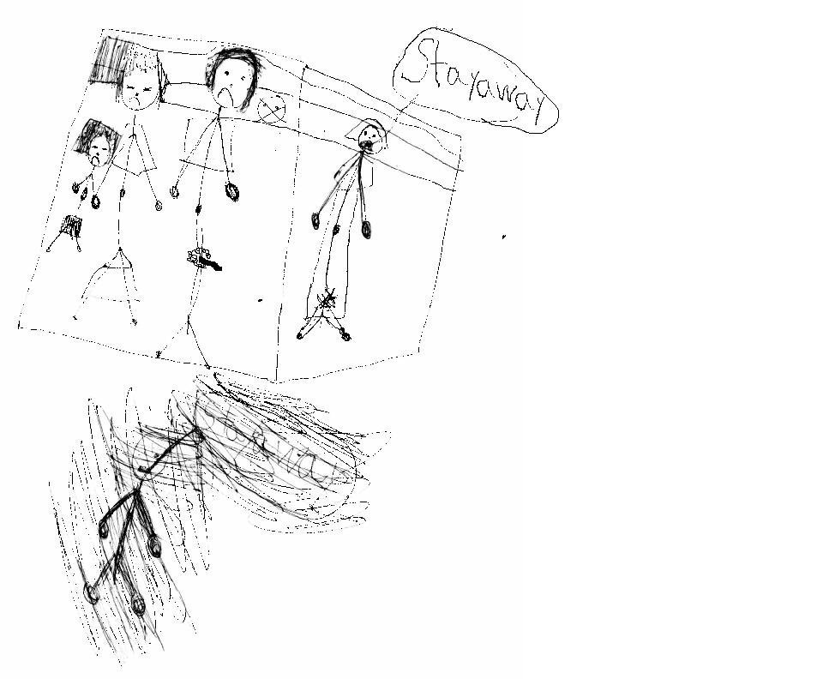
House of Worries
Children’s Advocacy Center, of the Thirteenth Judicial Circuit Court, Tampa, Florida
Core Pre-Service Curriculum – Lab 4.4.20

Slide 79
Lab Activity 10:
Asking child about details
Core Pre-Service Curriculum – Lab 4.4.21
Notes:
9.1.8

Slide 80
Other important questions
Associated sensory details (sounds, smells, taste)
How did this make you feel?
Is there anything you didn’t tell that you can tell me now?
Did this happen to anyone else?
  Who?
Who did you first tell this to?
  Next?
Core Pre-Service Curriculum – Lab 4.4.22

Slide 81
Disclosure sounds bizarre…
Perpetrator deliberate attempt to confuse or frighten child
Memory distortion related to trauma
Coping mechanisms
Developmental limitations
Core Pre-Service Curriculum – Lab 4.4.23

Slide 82
Lab Unit 4.5
Child Interviewing Skills Practice
Core Pre-Service Curriculum – Lab 4.5.1
Notes:
9.2.15

Slide 83
Learning Objectives
Review child interview skills checklist.
Demonstrate a child interview to learn about child’s care, people in the home and home environment.
Demonstrate observation of child interview.
  Lab
  Field
Based on field interview conducted, demonstrate written summary of information learned.
Core Pre-Service Curriculum – Lab 4.5.2
Notes:
9.2.16

Slide 84
Child Interviewing Skills
Opening Phase of Interview
  Build rapport
  Provide interview instructions
  Conduct language assessment
Core Pre-Service Curriculum – Lab 4.5.3

Slide 85
Child Interviewing Skills
Information collection
  Use clear language
  Use attending behaviors
  Ask appropriate questions
  Provide child with positive reinforcement
  Guide interview and questions from general to specific
Core Pre-Service Curriculum – Lab 4.5.4

Slide 86
Child Interviewing Skills
Closing Phase of Interview
  Discuss next steps
  Answer any questions child had
  Affirm child for sharing information
Core Pre-Service Curriculum – Lab 4.5.5

Slide 87
Lab Activity 11:
Skills Demonstration
Core Pre-Service Curriculum – Lab 4.5.6
Notes:
9.1.8

Slide 88

Congratulations!
Core Pre-Service Curriculum – Lab 4.5.7

